Slide 1
Bad Astronomy
By Jan Decker
PHY489.02
May 4, 2011

Slide 2
3 Misconceptions
The moon does not rotate
The moon generates one tide per day
The Sun's energy is not produced in its core, but on its surface.

Slide 3
Misconception I
The moon does not rotate.
Why does someone believe the moon does not rotate?
misconception – We are seeing the shadow of the earth on the moon.
Cannot be true – when the moon passes through the shadow of the earth, we get a lunar eclipse.

Slide 4
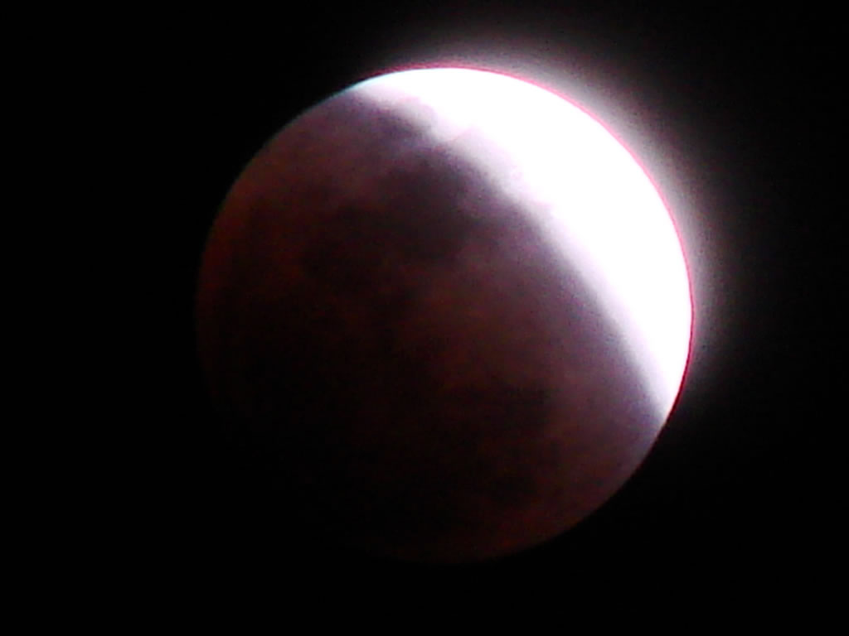
Reasons for misconception
Some believe we are seeing the shadow of the earth on the moon.
Not true!
Lunar eclipse happens when the moon passes behind the earth so the earth blocks the sun rays from striking the moon.
Notes:
The ancient Chinese thought that solar eclipses were caused by a dragon eating the Sun. They made a lot of noise to scare it away.

Slide 5
Misconception 1 The moon does not rotate
http://www.youtube.com/watch?v=7DNEI4VMKrw
Time for one rotation - 27.3 days to rotate once on its axis.
Time to orbit earth - 27.3 days to complete one orbit around the earth, we always see the same side of the moon.

Slide 6
Bad Astronomy 2
The moon generates one tide per day.
FALSE!
Tides are the vertical rising and lowering of sea level, and are greatly controlled by the gravitational pull of the sun and moon. Although the sun has a stronger gravitational attraction than the moon, the moon's relative nearness to the earth makes its gravitational pull more than twice as effective as the sun's.

Slide 7
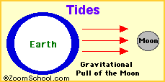
Tides – First explained by Isaac Newton
Gravitational attraction
of the moon, causes oceans
to bulge
Since the earth is rotating
while this is happening, two
tides occur each day.

Slide 8
Misconception 3 The Sun's energy is not produced in its core, but on its surface.
The major source of the sun's energy is the decaying central core.
The sun fuses hydrogen into helium.
Core is the hottest part of the sun.
Core produces almost all the sun’s heat via fusion.
The rest of the star is heated by energy that is transferred outward of the core.
Notes:
A cupful of gas from the photosphere contains a trillion times more gas particles than a cupful from the corona.

Slide 9
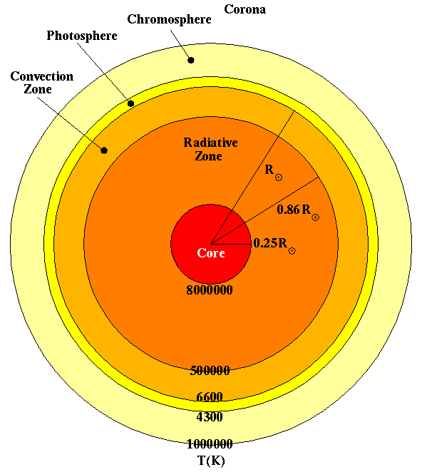
Source of Sun’s Energy

Slide 10
Eliciting
Idenitify
Confronting
Resolving
reinforcing

