Slide 1
Buoyancy
An illustration of the Levels of Inquiry Model of Physics Teaching

Slide 2
Discovery Learning Students develop concepts (and learn names for these new concepts) based on first-hand experiences. Students reflect on mental models, experience floating and sinking, as well as buoyant force.

Slide 3
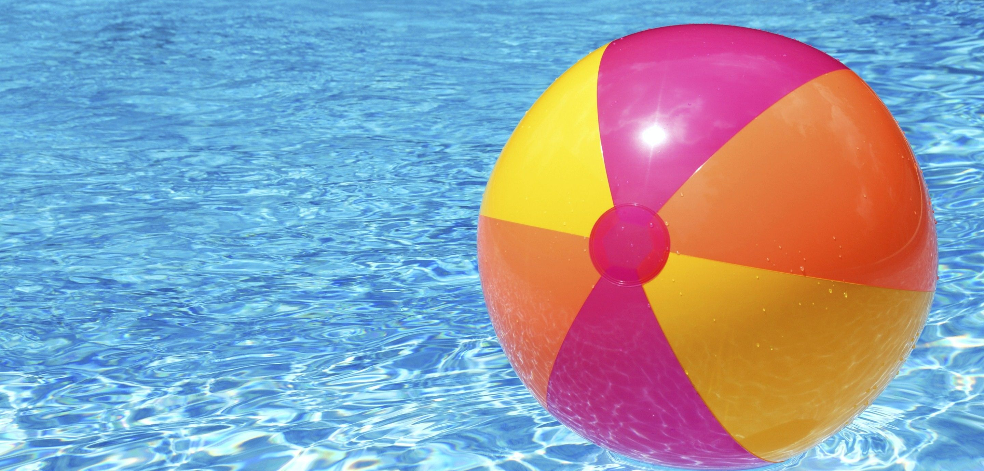
Why do beech balls float?
What happens if you push the beech ball beneath
the water and release it?

Slide 4
Have you ever lifted rocks under water?
What happens if you take them out of water?

Slide 5
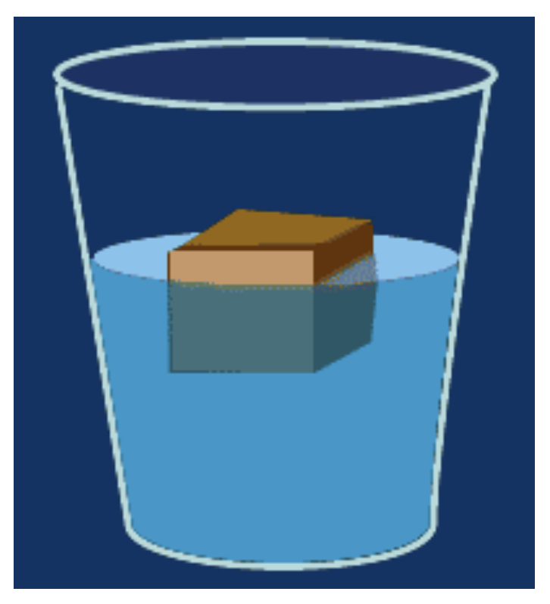
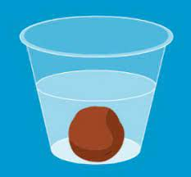
Why do some things float and other things sink?
Floating Sinking

Slide 6
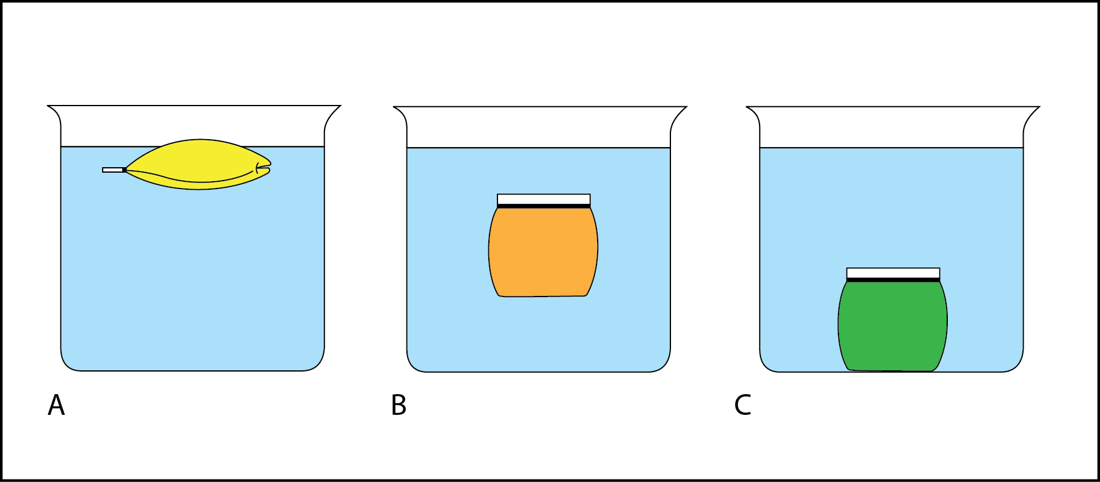
Density of the fluid = 1
Object density < 1
Object density = 1
Object density > 1
What is relationship between densities for sinking and floating?

Slide 7
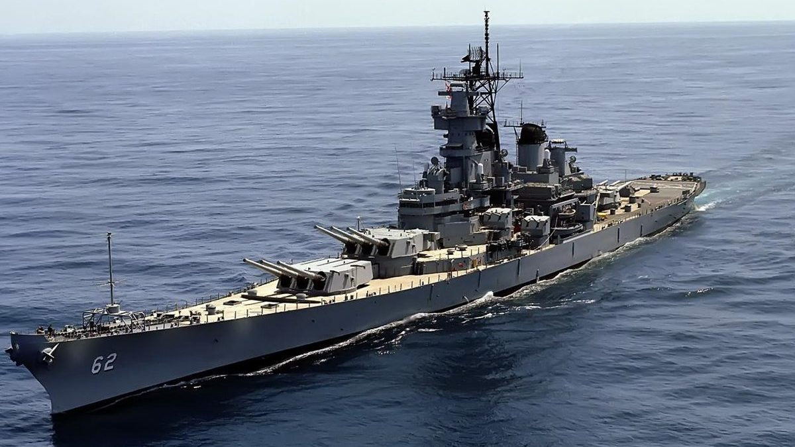
How can battleships float?

Slide 8
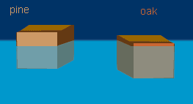
Floating things rest at different levels in the same fluid. Why is this so?

Slide 9
Interactive Demo Students are engaged in explanation and prediction-making that allows teacher to elicit, identify, confront, and resolve alternative conceptions. Students develop a relationship between weight in air, in water, and the buoyant force.

Slide 10
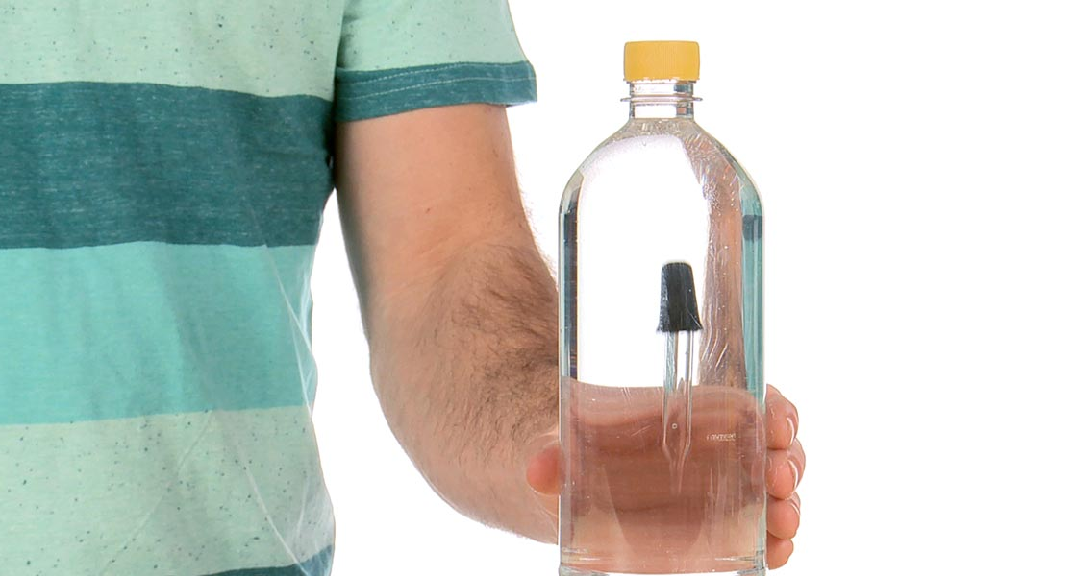
How does a Cartesian
Diver work?

Slide 11
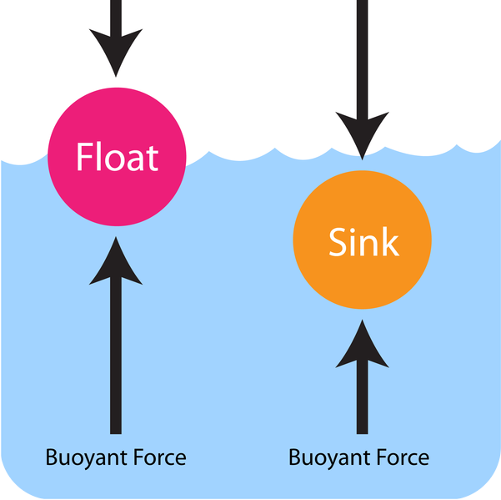

Slide 13
Inquiry Lesson Students identify scientific principles and/or relationships by working with a teacher who demonstrates the inquiry process and uses a “think aloud” protocol throughout. Students identify factors that might influence buoyant force and conduct simple tests.

Slide 14
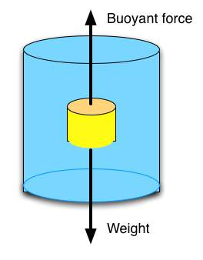
F_{b} is upward or +
W is downward or –
How can one determine F_{b}?

Slide 15
We can measure W_{air} and W_{water}
Can we use these to find F_{b}?

Slide 16
Find the relationship using data.
Weight suspended in air $≡$ W_{air} = 100 gmf
Weight suspended in water $≡$ W_{water} = 80 gmf
Buoyant force $≡$ F_{b} = ?
Now, give a general formula for W_{air}, W_{water}, and F_{b}.
$$−$$
$$=$$

Slide 17
How does one actually measure the buoyant force, F_{b}?

Slide 18
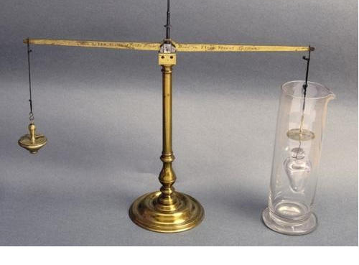
Galileo’s hydrostatic balance

Slide 19
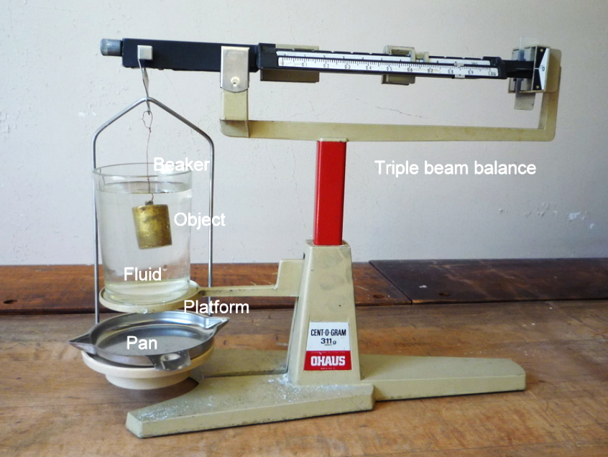
The physics classroom version of hydrostatic balance.

Slide 20
Factors that might influence buoyancy…
Listing of things:
Density of immersed object
Density of fluid
Volume
Shape
Depth
Orientation
Other?
How can we test these to see which, if any influence, buoyancy?

Slide 21
Conducting a controlled scientific experiment
One independent variable – the thing that I change.
One dependent variable – which is?
Every other variable held constant – why?

Slide 22
Data Collection and Analysis (example data) Which factors affect buoyancy?
Factor | Object/Fluid | W_{air} | W_{water} | F_{b} | Conclusion
Object depth | Ingot 1 | 100 gmf | 80 gmf | 20 gmf | Does not affect
 | Ingot 1 | 100 gmf | 80 gmf | 20 gmf
Obj. orientation | Block horizontal | 150 gmf | 110 gmf | 40 gmf | Does not affect
 | Block vertical | 150 gmf | 110 gmf | 40 gmf
Object density | Ingot 1 | 130 gmf | 105 gmf | 25 gmf | Does not affect
 | Ingot 2 | 110 gmf | 85 gmf | 25 gmf
Object volume | 100-g weight | 100 gmf | 85 gmf | 15 gmf | Does affect F_{b}
 | Plexiglas tube | 100 gmf | 65 gmf | 35 gmf
Fluid density | Water | 100 gmf | 80 gmf | 20 gmf | Does affect F_{b}
(Ingot 1) | Ethanol | 100 gmf | 90 gmf | 10 gmf

Slide 23
Inquiry Lab Students, working primarily on their own, establish empirical laws based on measurement of variables under controlled conditions. Students establish empirical law for volume of immersed object and density of liquid, F = $ρ$Vg.

Slide 24
Experimental Work (collaborative learning) Students already know how to create and interpret graphs.
Find the relationship between $F_{b}$ & $ρ_{f}$
Find the relationship between $F_{b}$ & $V$
Relationship is found to be linear. That is,
$$F_{b}∝ρ_{f}$$
Relationship is found to be linear. That is,
$$F_{b}∝V$$
If the above relationships hold, what it the relationship between all 3 variables?
$$F_{b}∝ρ_{f}+V$$
$$F_{b}∝ρ_{f}−V$$
$F_{b}∝ρ_{f}$V
$$F_{b}∝{ρ_{f}}/V$$
$$F_{b}∝V−ρ_{f}$$
$$F_{b}∝V/{ρ_{f}}$$

Slide 25
Conclusion
$$F_{b}∝ρ_{f}\text{V}$$
$F_{b}=kρ_{f}$V
$$k={F_{b}}/{ρ_{f}\text{V} }$$
$$k=\frac{9.8m}{s^{2}}≡g$$
$$∴F_{b}=ρ_{f}Vg$$

Slide 26
Real-world Applications Students solve problems related to authentic situations while working individually or in cooperative and collaborative groups using problem-based and project-based approaches. Students apply new knowledge to authentic situations individually or in small groups.

Slide 27
Problem sets are legitimate applications
Simulations with worksheets provide useful in helping students grasp mathematical concepts developed in inquiry labs. Below is an example. (NB. PhET doesn’t have an html5 version yet.)
https://ophysics.com/fl1.html

Slide 28
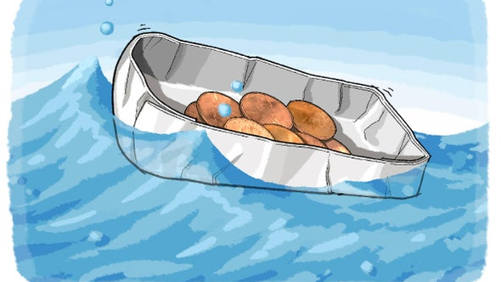
Given a limited amount of construction material, build a barge that can carry the maximum load.

Slide 29
Hypothetical Inquiry Students develop and test hypotheses that serve as tentative explanations for observed phenomena and guides for further experimentation. Students generate explanations for: pressure at depth, P = $ρ$gh source of buoyant force Archimedes’ Principle

Slide 30
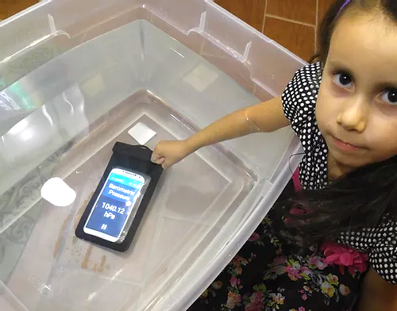
What is empirical the relationship between pressure and depth?

Slide 31
Explain the relationship between pressure and depth.
P = F/A
P = mg/A
P = ⍴gV/A
Now, V/A = dA/A = d
P = ⍴gd = const * d
P $∝$d
Stevin’s Law

Slide 32
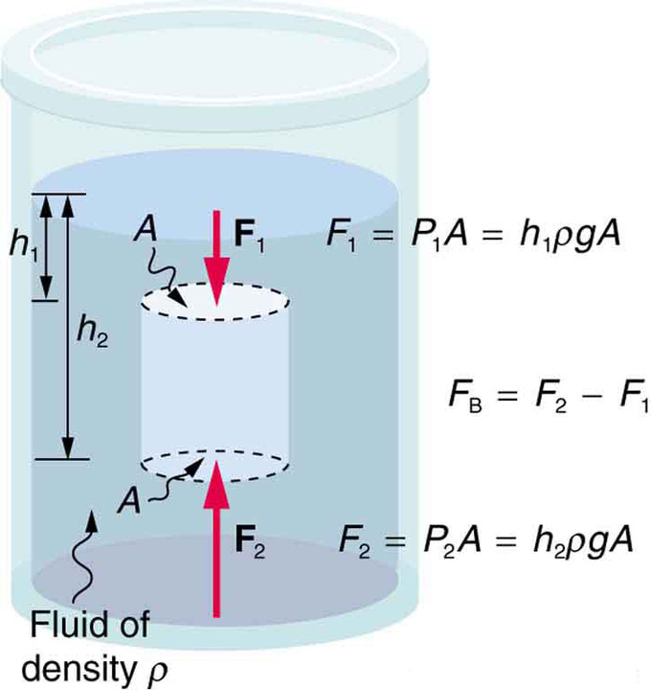
What is the origin of the buoyant force?

Slide 33
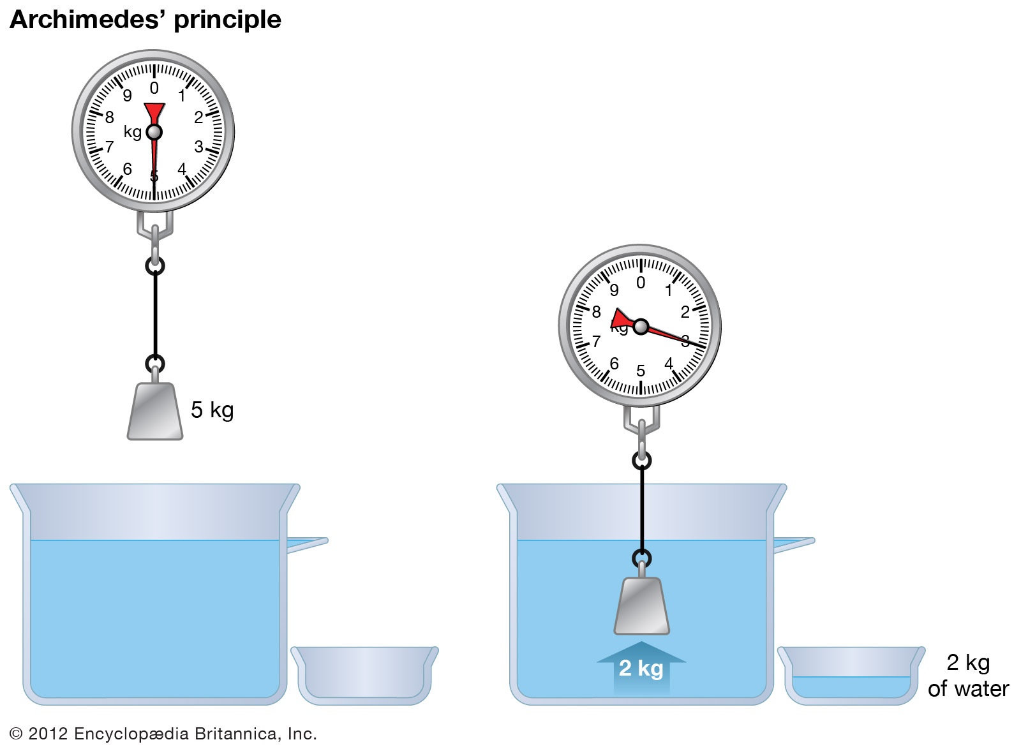
How do we explain Archimedes’ principle?

