Slide 1
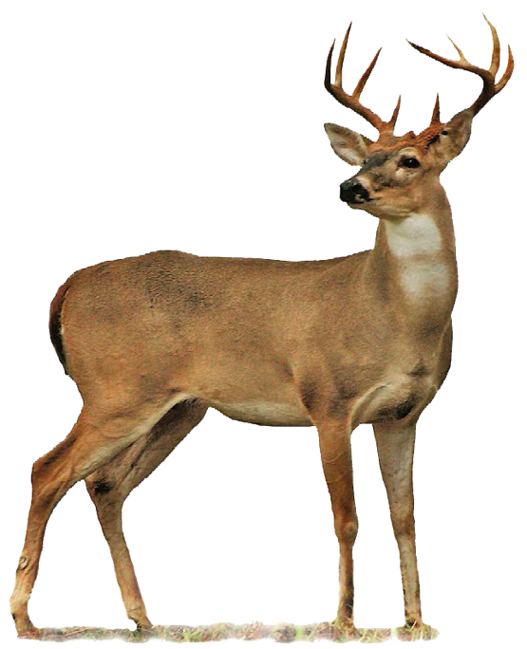
The Deer Problem
at Rock Cut State Park
(A PBL Activity Using Cooperative Learning)

Slide 2
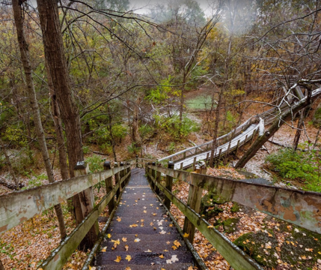
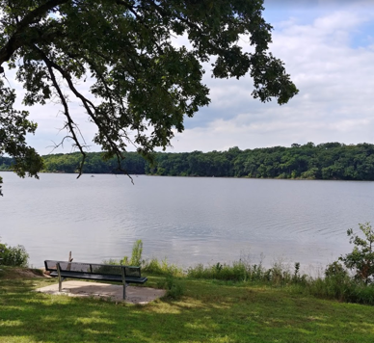
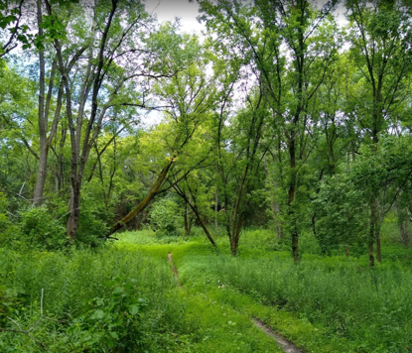
Rock Cut State Park

Slide 3
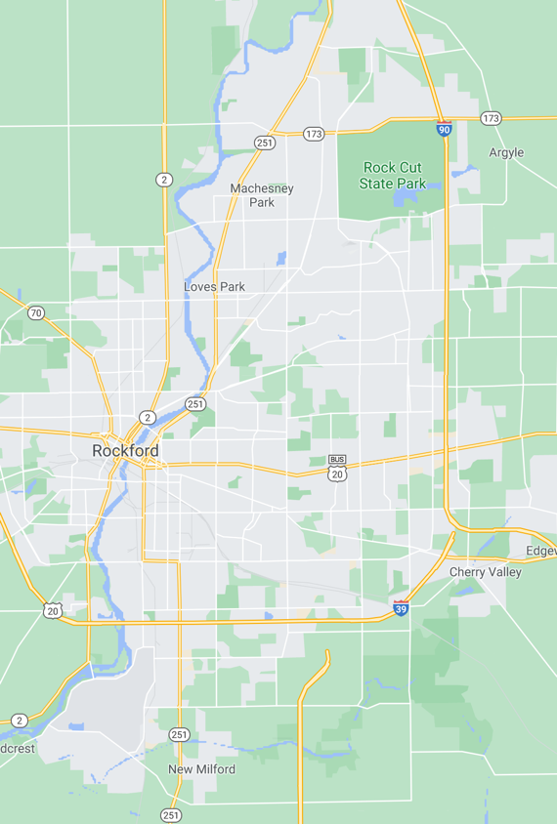
Park Description
Located in Loves Park, just northeast of Rockford, Illinois.
There are ten miles of trails at Rock Cut, seven of which are open to mountain bikers--the cross-country ski trails.
The trails are well maintained; in the winter months, park workers clear the trails for the cross-country skiers.

Slide 4
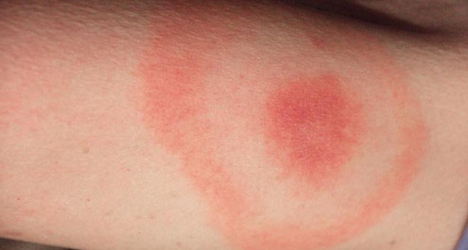
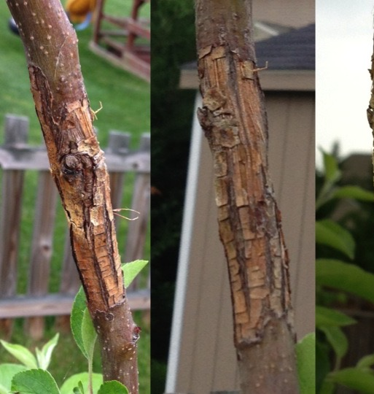
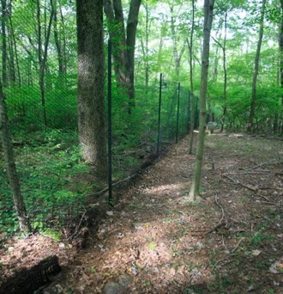
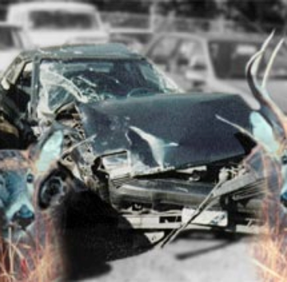

Slide 5
Deer-Car Collisions
Each year there are approximately 500,000 deer/auto collisions resulting in over 100 deaths and thousands of injuries.
Deer/auto collisions cost the auto insurance industry about $5,000 per claim.
The explosion in the deer population has led to the increase in deer/car collisions.
In the 1980's the deer population was approximately 10 million. Today, there are more than 35 million.

Slide 6
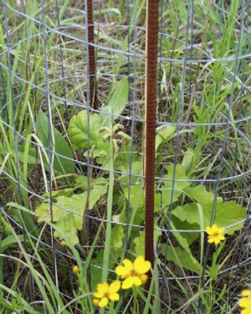
Deer Over Grazing
Eat trees and seedlings.
Stunted forests and pastures.
City nuisance to landscape artists and gardeners.

Slide 7
The Deer Tick Problem
Deer ticks feed on white tale deer
Deer tick carry Lyme disease
Lyme disease can cause joint pain, sore muscles, and a tired feeling.

Slide 8
Over Population

Slide 9
Sources of Problems
Milder winters than usual
Loss of natural predators
Deer foraging from unnatural sources
People feeding deer

Slide 10
How to Solve the Problem?

Slide 11
Problem Statement
You are a member of committee within the Illinois Department of Natural Resources.
You are charged with finding a way to solve the deer problem at Rock Cut Park.
You are charged with identifying strategies for helping to manage deer.
You are to present recommendations in the form of a proposal to the park superintendent.

Slide 12
Questions
What approaches can be used to solve problem?
What are the pros/cons of various approaches?
Which do you feel is the best approach?
Why is your approach the best one?
What would happen to the problem if your approach is chosen?
Do others strongly support or oppose your approach?
Should we even intervene?

