Slide 1
Teaching the Nature of Science
Dr. Carl J. Wenning
Illinois State University
Dr. Rebecca E. Vieyra
University of Colorado

Slide 2
What is “Nature of Science”?
There is no universally-agreed-upon definition.
In general, NOS includes topics such as:
  Epistemology: the study of knowledge and justified belief; how do we know what we claim to know
  Ontology: the study of relationships between concepts and categories, science and society
  Axiology: an understanding of the value of things
  History: a study of the developments of science.

Slide 3
Why NOS Literacy?
The goal of science education is to help students achieve science literacy.
The US Next Generation Science Standards (NGSS) definition of science literacy includes:
    Science as inquiry
    Science content
    Science and technology
    Science in personal and social perspectives
    History and nature of science
    Unifying concepts and processes

Slide 4
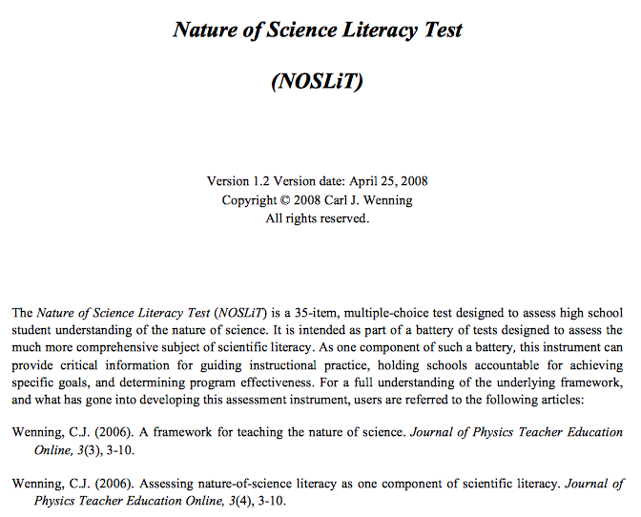
What does NOS Look Like?
Sample assessments (INOS, VNOS, NOSLiT)

Slide 5
What does NOS include?
According to the NOSLiT definition (suitable for the teaching of school students), a basic understanding of the nature of science requires six essential understandings…
      Scientific Terminology
      Scientific Process Skills
      Rules of Scientific Evidence
      Assumptions of Science
      Scientific Dispositions
      Major Misconceptions

Slide 6
Scientific Terminology
hypothesis
assumption
proof
evidence
principle
induction
law
others?

Slide 7
38
Accuracy
Explanation
important
Fact
Independent
terms
Principle
Proof
Assertion
Assumption
Belief
Blunder
Control
Data
Deduction
Empirical
Error
Evidence
Faith
Falsifiable
Hypothesis
Induction
Knowledge
Law
Model
Objective
Parameter
Precision
Prediction
Dependent
Pseudoscience
Relationship
Repeatable
Science
Scientific
Subjective
System
Theory
Truth
Variable
…

Slide 8
Scientific Process Skills
Generating principles through induction
Explaining and predicting through deduction
Identifying and controlling variables
Using technology and math during investigations
Observing and recording data
Constructing a graph to ﬁnd relationships
Designing and conducting scientiﬁc investigations
Drawing conclusions from evidence
Communicating results

Slide 9
Rules of Scientific Evidence
For a claim to be scientiﬁc, it must be testable.
The ultimate authority in science is empirical evidence.
Scientiﬁc conclusions must be based on objective evidence.
Correlation should not be confused with cause and effect.
Scientiﬁc claims, to be acceptable, must not conﬂict with what is known with relative certainty.
Scientists should be skeptical of claims that conﬂict with accepted views of reality.
Scientists should test and independently verify all signiﬁcant and apparently justiﬁable claims.

Slide 10
The more unconventional a claim, the greater the requirement for supporting evidence.
Scientists must not make selective use of evidence.
Only one positive instance is required to refute a negative claim.
Multiple positive instances alone cannot prove a positive claim unless all cases are examined.
One should not assume as certain that which one is attempting to demonstrate.
If several explanations account for the same phenomenon, the simplest explanation is preferred (Ockham’s razor).
Others?

Slide 11
Assumptions of Science
All laws of science are universal and not merely local.
Nature operates consistently in both time and space.
No observed effect exists without a natural cause.
Scientists do not accept explanations for which no test is available.
Science admits natural entities whose existence can be theoretically inferred through reason.
Scientiﬁc knowledge is durable but tentative
Proofs beyond a reasonable doubt are possible.
Science is not a private matter.
CAUTION: These philosophical statements should preclude scientism. Scientism is a self-refuting claim.

Slide 12
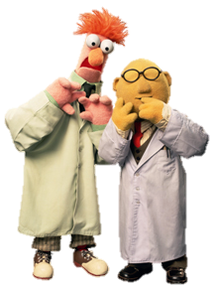
Scientific Dispositions
curious and skeptical
objective and not dogmatic
creative and logical
honest and trustworthy
courageous yet empathic
autonomous and confident
Others?

Slide 13
Major Misconceptions
There exists a scientiﬁc method that is general and universal.
Hypotheses are only educated guesses.
Hypotheses turn into theories that eventually become laws.
Scientiﬁc knowledge is based mainly on experiment.
High objectivity is the hallmark of science.

Slide 14
Scientists always review and check the work of their colleagues.
Certainty results when facts are accumulated and analyzed.
Science is less creative than it is procedural.
The scientiﬁc method leads to absolute truth.
All questions posed about the universe can be answered by the processes of science.
Others?

Slide 15
Learning the Nature of Science
NOS is not learned effectively through “osmosis.”
NOS literacy is not developed after only one lesson.
NOS is learned through multiple and varied means.
I have proposed a NOS Learning Model…

Slide 16
NOS Learning Model
Achieving NOS Literacy
Background Readings
Explicit Characterization
Case Study Discussions
Inquiry-oriented Learning
Historical Studies
Varied Assessments

Slide 17


Background Readings
Content of science
Nature of science

Slide 18

Explicit Characterization
Epistemology – how we know what we know.
  Human Reason
  Personal Experience
  Artificial Inference
  Natural Inference
  Definition
  Universal Consent
  Perfect Credibility
  Scientific Observation and Experimentation

Slide 19
Case Study Discussions
Arif and Selly are working on a homework project dealing with weather forecasting. One of the questions they have been asked to answer by their teacher is, “Is weather forecasting a science or a pseudoscience?”
Arif says, “Yes, weather forecasting is a science. Weather forecasters collect data and make predictions based on that data. They do lots of research to get things right.”
Selly objects, “I disagree. Weather forecasting is a pseudoscience. It should not be confused with the science known as meteorology. Think about it; forecasters often get things wrong. In fact, they are wrong quite a lot, and they can collect all the data they need.”
Who is correct?

Slide 20

Inquiry-oriented Learning
Discovery learning
Interactive demonstrations
Inquiry lessons
Inquiry labs
Real-world applications
Hypothetical inquiry

Slide 21
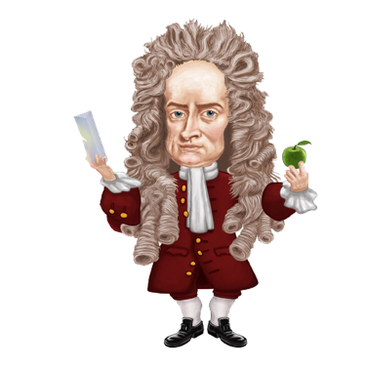
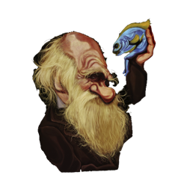
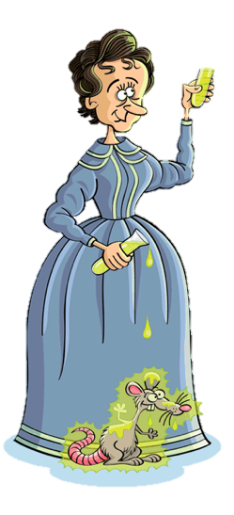
Historical Studies
Newton’s derivation of the law of gravitation
Galileo’s rejection of the Ptolemaic system
Mendeleyev’s periodic table of elements
Proust’s law of chemical proportions
Curie’s discovery of radium
Mendel’s law of inheritance
Darwin’s theory of evolution
Wegener’s continental drift/plate tectonics
Hubble’s Big Bang origin of the universe

Slide 22


Varied Assessments
Writing reports and essays
Whiteboard dialogues
Labs and lab reports
Student presentations

