Slide 1
Epistemology (Faith & Reason: Friend or Foe?)
Dr. Carl J. Wenning
Department of Physics
Illinois State University

Slide 2
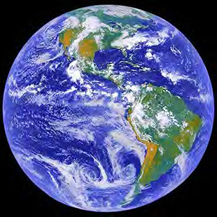
How can we know anything?
We say that Earth is spherical….
We say that Earth orbits the sun annually….
We say that Earth spins daily on its axis….
Do we know, or do we merely have faith?

Slide 3
If the Earth is spinning,…
we should feel the motion,
we should feel the winds,
we should see the oceans cast off,
we should see projectiles left behind,
and yet we don’t.

Slide 4
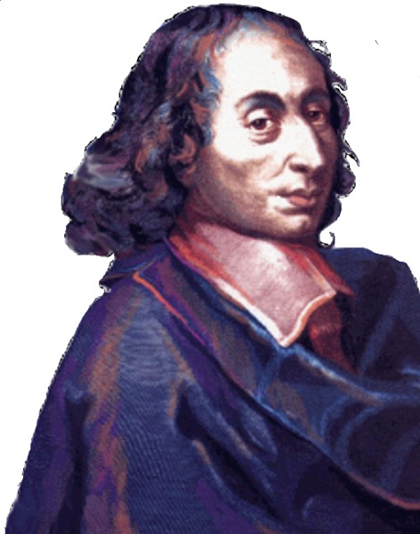
According to Blaise Pascal,
“Opinion is the mistress of error; she cannot make us wise, only content.”
Right reason and empirical evidence together serve as the basis of scientific knowledge.

Slide 5
Human reason is limited
We are weak in our infirmities.
Outlook can sway our reason:
We believe what we want to believe.
We take facts as opinions if we don’t agree, and opinions as facts if we do agree.
We can gain false first impressions.
It was once thought that heavier things would fall faster.
If we can’t trust reason alone, then how can we actually know anything?

Slide 6
Paths to Knowledge
If we claim to know something, then we should be able to:
state the source of that knowledge.
answer “How do you know?”
There are many ways to know things:
Trust in legitimate authorities
Trust in reason
Trust in empirical evidence
Still, not all paths are free of danger.

Slide 7
Personal Experience
When you have burned your hand, you know it.
If you see someone shot, you know it.
Caution: Identical concrete experiences can be interpreted a multitude of ways (e.g., witnesses)

Slide 8
Artificial Inference
Axiomatic proofs of mathematics.
4x + 2 = 6
Therefore, x = 1
Caution: These conclusions can be flawed if one doesn’t know and understand the rules (e.g., 2 = 1).

Slide 9
Natural Inference - Syllogisms
Humans, when cut, bleed.
I am human.
Thus, when cut I’ll bleed.
Caution: The primary and/or secondary premises can be flawed.
Gravity pulls more strongly on heavier objects.
Greater forces produce greater accelerations.
Heavier objects fall faster than do light objects.
Modus ponens

Slide 10
Definition
An author is some one who writes a book.
Therefore, any one who writes a book is an author.
Caution: Definitions do not constitute knowledge per se. You might know the name of something, but nothing about it.

Slide 11
Universal Consent
Indiana is between Ohio and Illinois.
The Eiffel Tower is in Paris, France.
Caution: Just because “everyone” believes something to be so, doesn’t make it so. It was once believed that diseases resulted from humans having displeasured the gods, that the Earth was flat, and that the Earth was at the center of the universe

Slide 12
Perfect Credibility
A boxed animal sounds like a dog, barks like a dog, feels like a dog, licks your fingers like a dog, smells like a dog. Thus, it must be a dog.
Caution: All the evidence at one time pointed to the fact that the Earth stood still, but today scientists claim to know that it both rotates daily on its axis and revolves annually around the Sun.

Slide 13
Credible Authority
What is your name? How do you know?
Thanksgiving is a legal holiday. How do you know?
Caution: Not all authorities are credible. Many leaders preach contradictory beliefs. They can’t all be correct.

Slide 14
Science: Observation
Asking a question about a natural phenomenon
Making observations of the phenomenon
Hypothesizing an explanation for the phenomenon
Predicting a logical consequence of the hypothesis
Testing the hypothesis by an experiment or further observation
Drawing a conclusion or creating a revised hypothesis based on new data

Slide 15
Science: Experimentation
Observational facts & problem identification
Hypothesis generation & prediction
Experimentation:
Can data disprove a hypothesis?
Can data support a hypothesis?
Can data prove a hypothesis?
If data support hypothesis, then prediction… experimentation…prediction…
Theory development (misconception: theories become laws)

Slide 16
Science: Analysis
Derivation of knowledge using logic & empirical evidence.
Induction – moving from specific cases to general rules
Principles
Laws
Deduction – moving from general rules to specific cases
Proof - evidence or argument establishing or helping to establish the correctness of a statement:
Earth as a spherical shape
Earth spins daily on its axis
Earth orbits the Sun annually

Slide 17
What is truth?
Truth is “what is.” Something that is true is consistent with reality.
Two types of truth:
Subjective – in relation to the subject (e.g., I think that the painting is beautiful – This truth is in the eye of the beholder)
Objective – in relation to the object (e.g., The painting is hanging on the wall – This truth is consistent with what is.)
Objective truth is the goal of science, but scientists never claim to possess it. Scientific knowledge is subject to revision in the light of new evidence.

Slide 18
What is Science?
Science is a truth-seeking process
Science is a body of knowledge based on right reason and empirical evidence
Caution: Deeper truths exist even when objective truths contradict (relativity).
Science is limited to the physical realm.

Slide 19
Science does not explain all.
Origin of the universe
Origin of the fundamental laws of nature
Fine-tuning of the universe
Origin of life
Origin of consciousness
Existence of moral laws
Intrinsic values (life, liberty, happiness, human rights)

Slide 20
What is Faith?
Secular Faith (the “assumptions” of science)
Scientists have faith that the rules of science are the same everywhere in the universe.
Scientists have faith that the processes we see in operation today operate in past, present, and future.
Religious Faith
Often based on authority, but sometimes based on personal experience, emotion, philosophy, etc.
A “perfection of reason” that illuminates the mind (e.g., the Kalam argument and fine tuning argument for the existence of God)

Slide 21
Faith & Reason are Belief Systems
Faith is belief based upon certain assumptions, presumed authority, and logic – statements of faith generally ARE NOT testable.
Science is belief based on empirical evidence and logic – statements of knowledge ARE testable.
When you say you know a fact, you can cite evidence for that knowledge.
Knowledge can be subject to error and is, therefore, tentative and subject to change
Scientific knowledge in particular is durable.

Slide 22
Relationships
Science, philosophy, and theology are all ways of knowing something.
To suggest that science has all the answers is scientism.
As Thomas Aquinas said, “Faith is the perfection of reason.”
Reason and faith are allies…

Slide 23
Philosophy as an Avenue to Truth
Science cannot answer questions such as:
Which is more important, rights of individuals or society?
Are all men created equal?
What constitutes inalienable rights?
Which rights have priority over the others?
Life
Liberty
Pursuit of happiness
Property
Privacy

Slide 24
Theology as an Avenue to Truth
Does God exist?
Is there an after-life?
Do humans have immortal souls?
What is the purpose of life?
What must we do to save our souls?

Slide 25
Allies of truth
Faith
Reason
Philosophy
Theology

