Slide 1
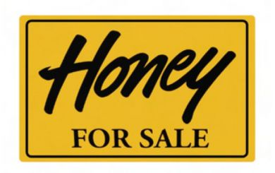
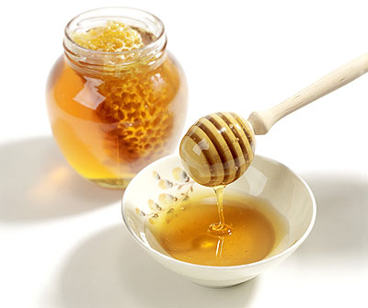
Extracting, Grading, Bottling and Selling Honey
with Jenny Kamm
Visuals from millerbeesupply.com and dailyfitnessmagz.com

Slide 2
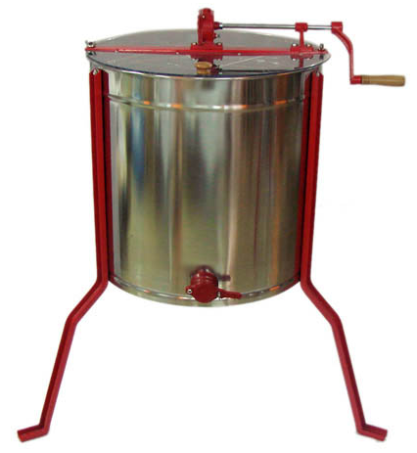
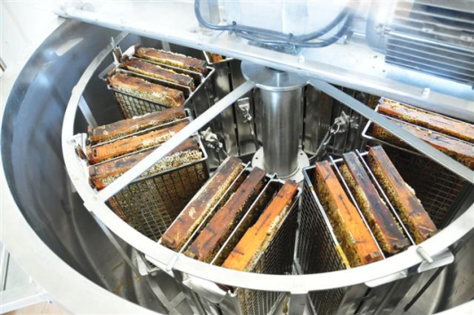
Extracting
The most convenient way to remove the honey from the comb is with the use of an extractor.
Or:
use someone else's equipment
crush the comb thereby squeezing out the honey
uncap the honey and allow it to drip from the comb.
* If the honey has too much moisture, it ferments!!!
Visuals from beechwoodbees.co.uk and bouteljeproducts.co.nz

Slide 3
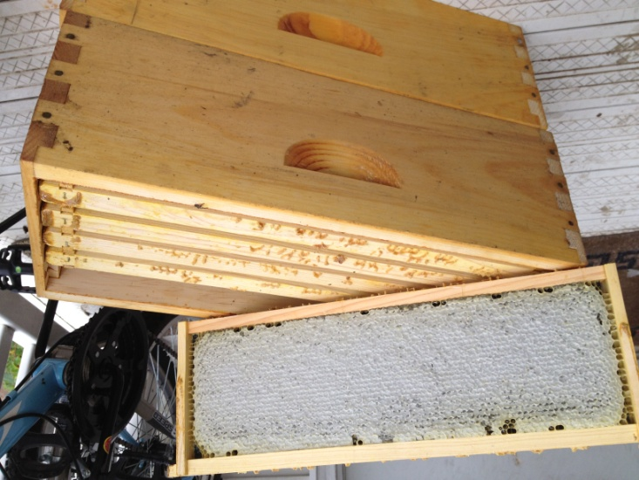
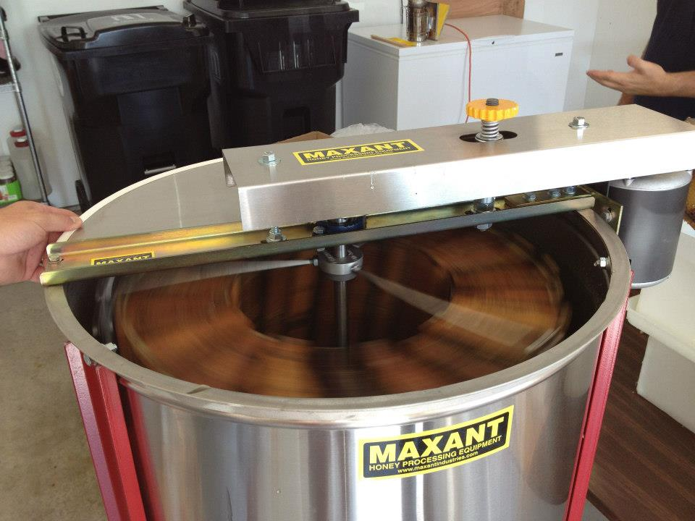
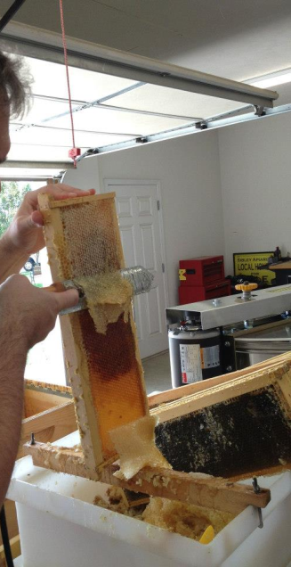
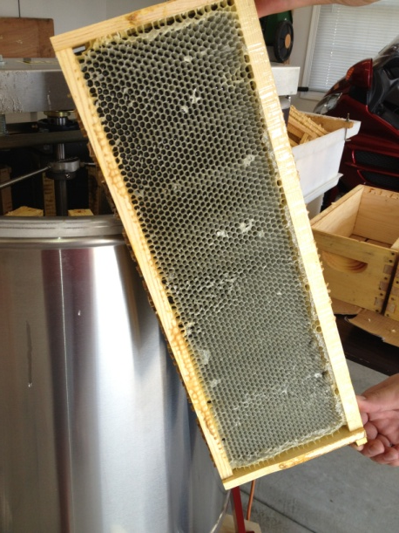
3
1
2
4
At the end, you have an empty frame that can be reused.

Slide 4
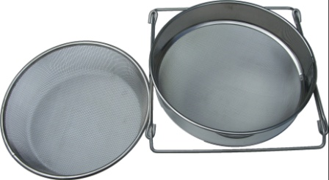
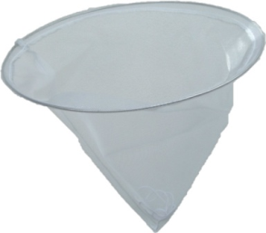
Filtering
When extracting honey, filter out…
any unwanted hive debris
bits of wax
anything else that tends to appear in extracted honey no matter how carefully you perform the extraction process.
A double filtration system (when large particles are found in the extracted honey)
1. The first strainer or sieve (e.g. household strainer)
2.The second strainer or sieve (e.g. fine-mesh nylon)
Visuals from beehivesupplies.co.uk

Slide 5
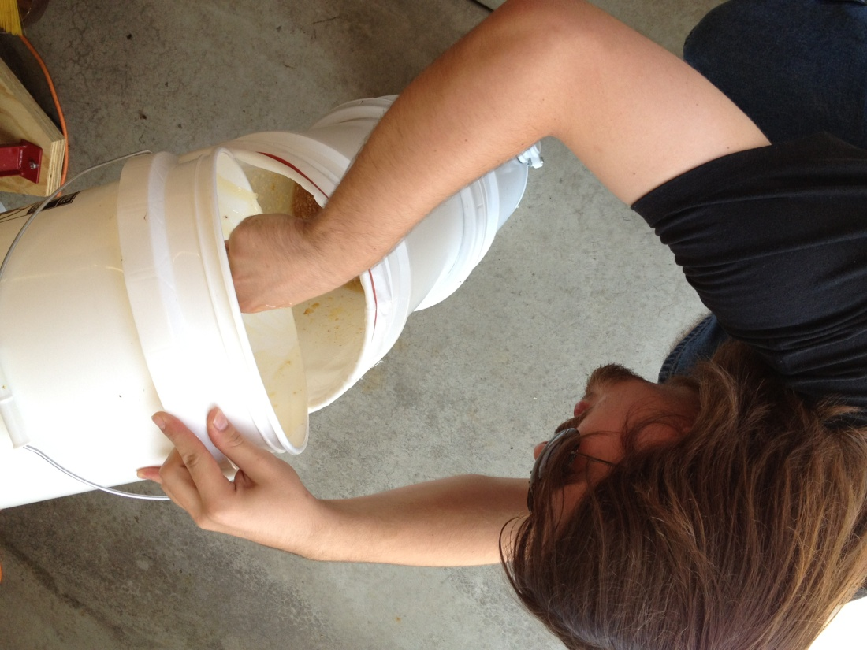
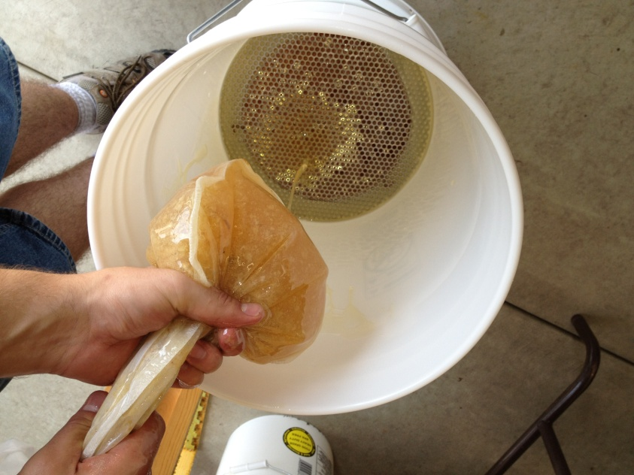
1
2
3

Slide 6
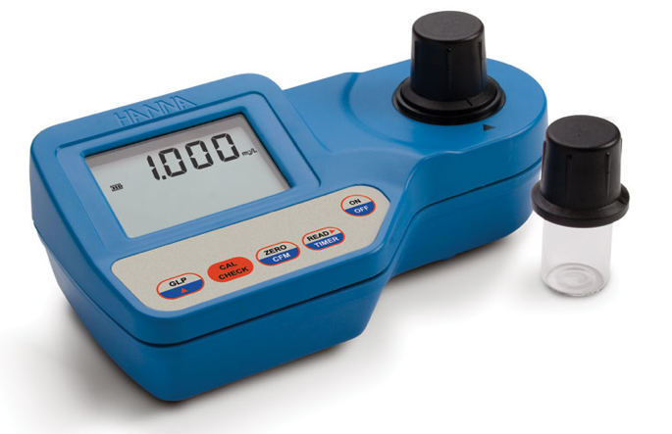
Grading Color
Uses honey color analyzer and Pfund scale (< 8 to > 114)
Color grades:
Water white < 8
Extra white 8-17
White 17-34
Extra light amber 34-50
Light amber 50-85
Amber 85-114
Dark amber > 114
Lighter honeys typically hive milder taste and sell for more.

Slide 7
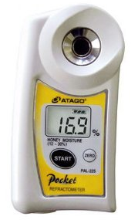
Determining Moisture
Honey contains yeast and with moisture > 17-18%, this can lead to fermentation at room temperature.
If honey is completely capped, it will usually have moisture content of less than about 18%.
Honey moisture refractometer determines % moisture.
Calculates moisture from refraction of light beam passing though a sample of honey.

Slide 8
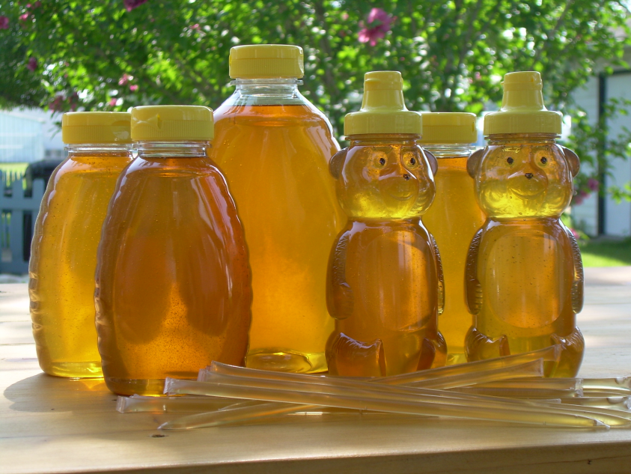
Bottling
Remember:
Make sure the bottle is labeled, appealing and properly packaged
Use commercial honey bottles/nice looking canning jars
Avoid unsightly used mayonnaise jars and the like
Fill the honey nearly to the brim (leaving about 1/4 inch of air space for expansion)
Visual from honeygirlhoney.com

Slide 9
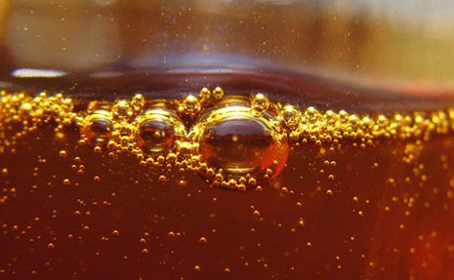
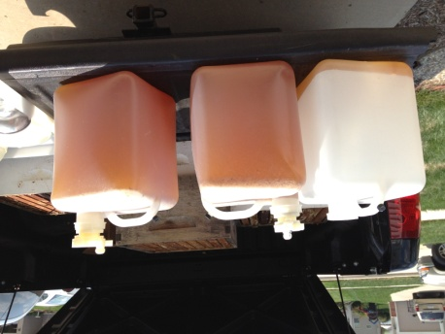
Bottling (con’t)
Visual from blogher.com
Using commercial equipment and filters to extract honey will produce a large number of tiny bubbles, so:
Empty your honey from a container with a gate at the bottom.
Maintain sanitary conditions.
Observe state health codes with regard to bottling and product labeling.
Contact your local Department of Health or your local beekeepers' association for details.

Slide 10
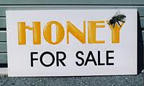
Selling
A year of work = 75-200 pounds of honey per colony
Good ways to sell your honey:
Take it to 4-H meetings, club meetings, social events, to the local farmers' market and such.
Give away honey as forms of advertising.
When you do sell honey, don't under price it.
Don’t undercut other beekeepers who are selling commercially.
If you sell more than a small amount of honey, be certain to obtain a business permit, and collect sales tax in accord with the law.
Visuals from wpclipart.com and wired2grafix.com

Slide 11
Resource Page
Information taken from Carl J. Wenning (2012) Extracting, Bottling, and Selling Honey. Article.
Information taken from Norman Gary, PhD (2010) Honey Bee Hobbyist: The care and Keeping of Bees. Book.

