Slide 1
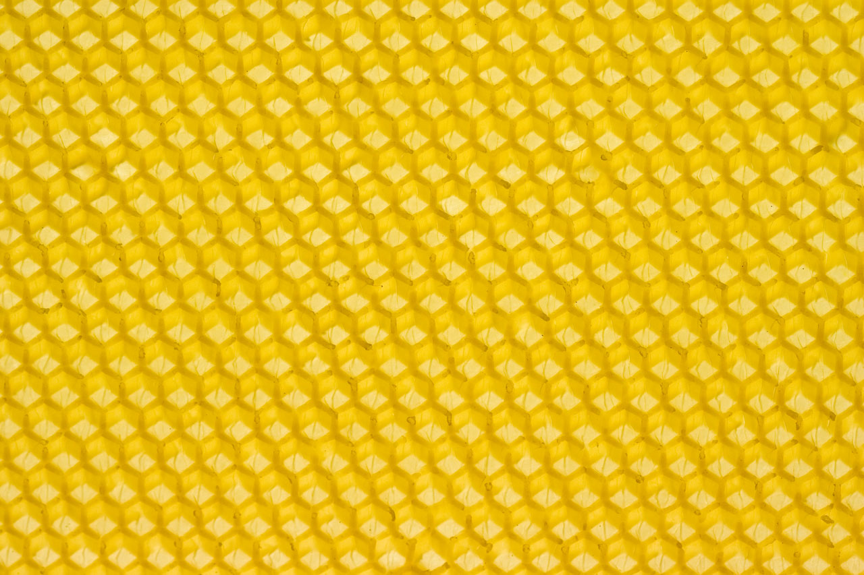
Maximizing Honey Production
Based on an article by the same name published in American Bee Journal, July 1999, Carl J. Wenning

Slide 2
Critical Understanding #1
A single large colony will produce much more honey than two colonies half its size.
  Consider one hive with 60,000 bees and two hives with 30,000 bees each.
  Assume that 20,000 house bees are required to conduct house keeping in each hive.
  The single large colony will have 40,000 foragers compared to only 20,000 foragers for two smaller hives.

Slide 3
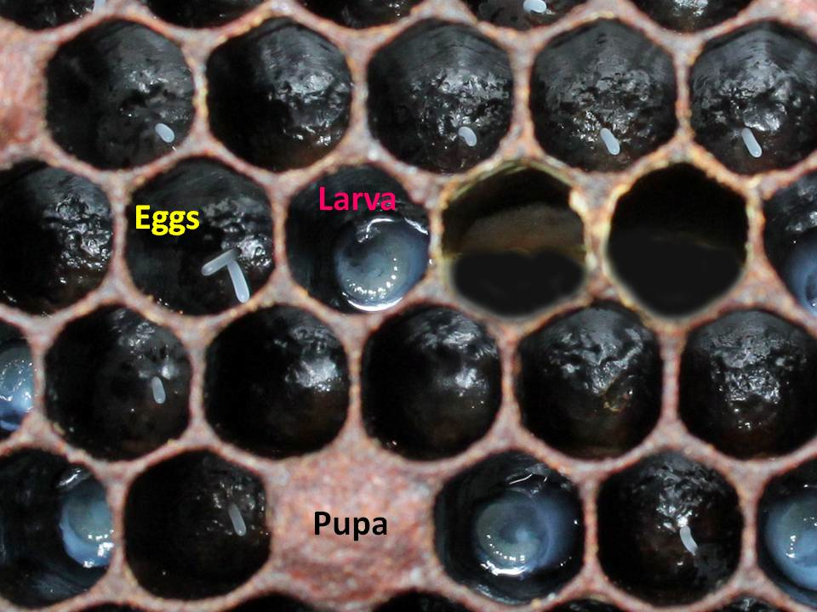
Critical Understanding #2
About 6 weeks are required for newly laid fertilized eggs to develop into worker bees, and for these house bees to become foragers.
  3 days as eggs
  5.5 days as larvae
  12.5 days as pupae
  23 days as house bees
  Only about 42 days do house bees begin to forage

Slide 4
Rule #1 – Place apiaries and hives in appropriate locations.
Bees need nectar and pollen sources to feed, and produce both brood and honey.
Bees forage mostly within 2-3 miles of a hive.
Ornamental plants, clovers, and some field crops provide forage.
Not all plants produce nectar (corn).
Rural monocultures are not good placements.

Slide 5
Rule #1 – Place apiaries and hives in appropriate locations.
Do place hives where they get early morning sunlight.
Don’t place hives in locations where they get direct sun all day.
Don’t place hives in depressions where it might be cold and humid.
Do ensure that bees have access to water.

Slide 6
Rule #2 – Determine the time of the first major nectar flow.
Use a hive on a scale to determine the time of nectar flow in an area; the first appearance of flower blossoms is usually a poor indicator.
The average date of the first central Illinois nectar flow is May 10th (Long Lane Honey Farm).
Once the date of the first major nectar flow is known, plan to start building up colony populations at least 6 weeks prior.
Build the colony population for the nectar flow, not on the nectar flow.

Slide 7
Rule #3 – Feed nectar and pollen substitutes early.
Queens do not rule the hive; rather, they start laying eggs profusely when heavily fed.
At least 6 weeks prior to the first major nectar flow, start feeding 1:1 nectar and pollen patties. In central Illinois this means by March 20th.
Do not overfeed sugar syrup as comb could become overfilled leaving no room for actual honey production. Early supering is best.

Slide 8
Rule #4 – Do your best to prevent colonies from swarming.
Causes of swarming are not really know with certainty; swarming is the way of replicating.
Many triggers: hive congestion, not enough storage space, old queens, etc.
Occurs before the first major nectar flow.
Avoid conditions leading to swarming by supering early, and reversing hive bodies if queen is not laying near bottom.
Avoid splitting a colony to reduce congestion.

Slide 9
Rule #5 – Keep only young, well-fertilized queens.
Old queens do not produce sufficient mandibular hormone to prevent queen rearing by workers; this leads to swarming.
Queens more than a year or two old, and those insufficiently fertilized, should be replaced.
Take your loses in the autumn by replacing queens then and not in the spring.
Select your strain of bees to fit nectar flows.

Slide 10
Rule #6 – Provide adequate and timely supering.
Nectar is typically 50-80% water, and bees distribute it across the hive to provide a large surface area to help drive off water.
Without adequate storage space, bees cannot produce honey efficiently and might swarm.
Super early and to excess.
Studies have shown that excess bees wax can stimulate honey production.

Slide 11
Rule #7 – Use supers with drawn comb.
The production of wax is time consuming and energy intense.
One of the beekeeper’s greatest assets is drawn comb.
Use captured swarms to draw out new comb.
At the end of the season take the increase from the swarm and add it and newly drawn comb and frames to a producing colony.

Slide 12
Rule #8 – Create entrances in upper level supers.
Properly vent or make additional holes at the top of a hive to allow for the escape of heat and water vapor.
Upper entrances allow foragers to avoid the congestion of brood chambers and go immediately to supers.
Upper entrances allow foragers to avoid any queen excluder that some beekeepers call “honey excluders”.

Slide 13
Rule #9 – Minimize wasteful wax production.
It takes about 8 pounds of honey to produce one pound of wax.
Wasteful wax production – such as burr comb and bridge comb – takes away from honey production.
Be certain to observe proper “bee space”.
When extracting, be cautious with the comb when uncapping the honey.

Slide 14
Rule #10 – Treat effectively for parasites and diseases.
Don’t think you’ll never be affected by diseases and pests.
Parasites and diseases sicken bees and reduce their honey-production capacity.
Treatment might take the form of chemicals or, better yet, with integrated pest management.

Slide 15
Integrated Pest Management
Purchasing only new equipment.
Putting up with acceptable levels of infestation
Genetic control (selecting proper queens)
Mechanical control (replacing old comb, using screened bottom boards, oil-based traps, storing supers on hives or in open)
Promoting rapid bee population growth
Soil treatments (small hive beetle)
Minimal chemical control (last resort)

Slide 16
Following these rules…
I was able to average 215 pounds of honey per colony in six colonies in 1998 (my second year of beekeeping).
For a complete complete summary and additional details, see Wenning, C.J. (1999). Maximizing Honey Production, American Bee Journal, 139(7), 523-526.

