Slide 1
Products of the hive
Tom Pankonen
Honey Pimp Apiairies

Slide 2


Slide 3
Honey
  Bottled, chunk, creamed, and comb
Wax
Propolis
Pollen
Pollination
Fermented Goodies

Slide 4
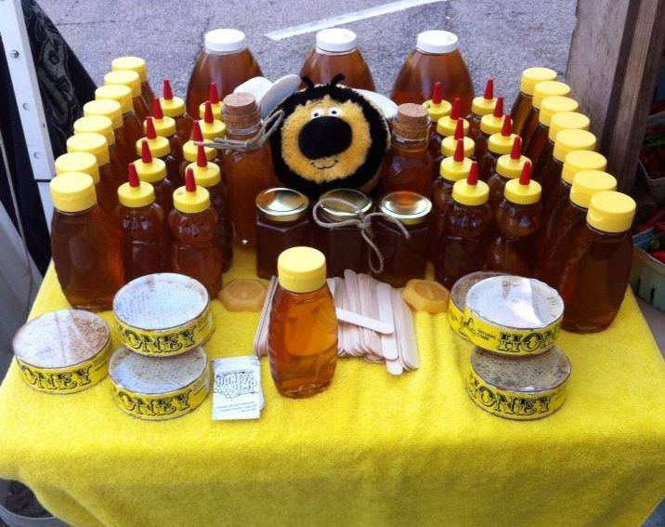
Types of honey packaging

Slide 5
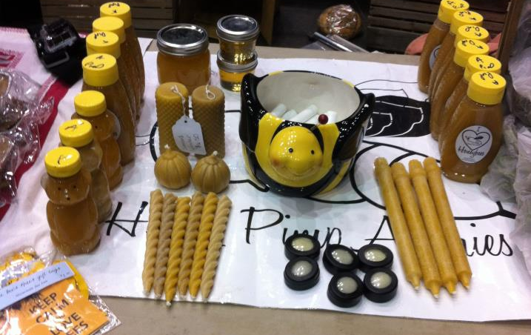
Thanksgiving Market

Slide 6
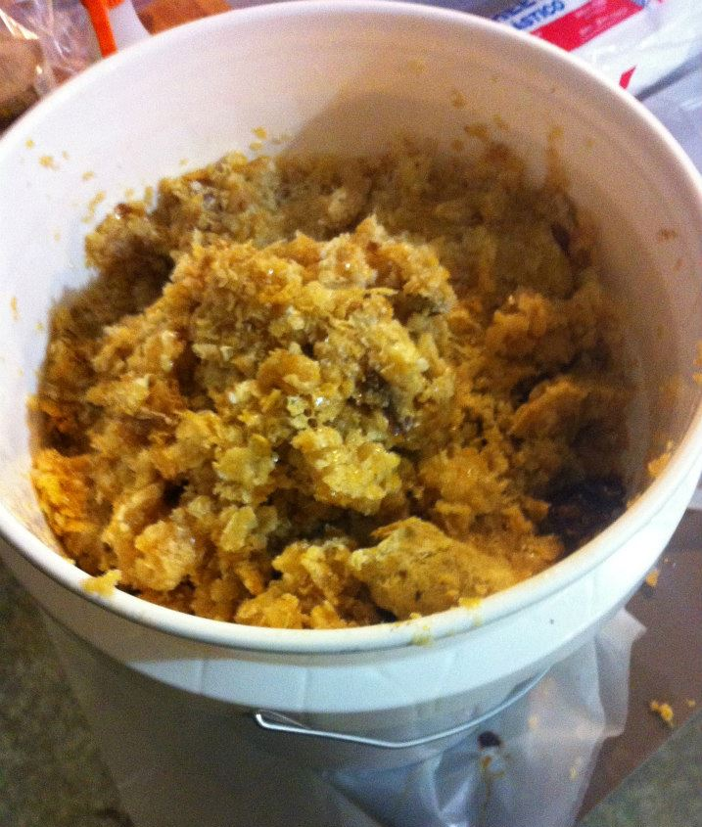
Wax

Slide 7
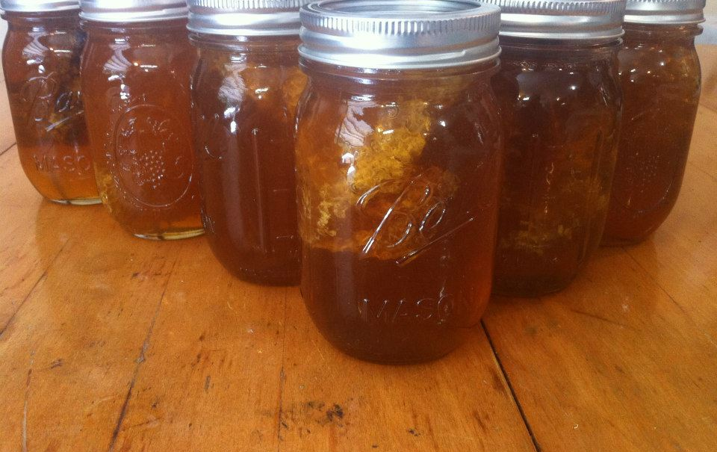
Chunk Honey

Slide 8
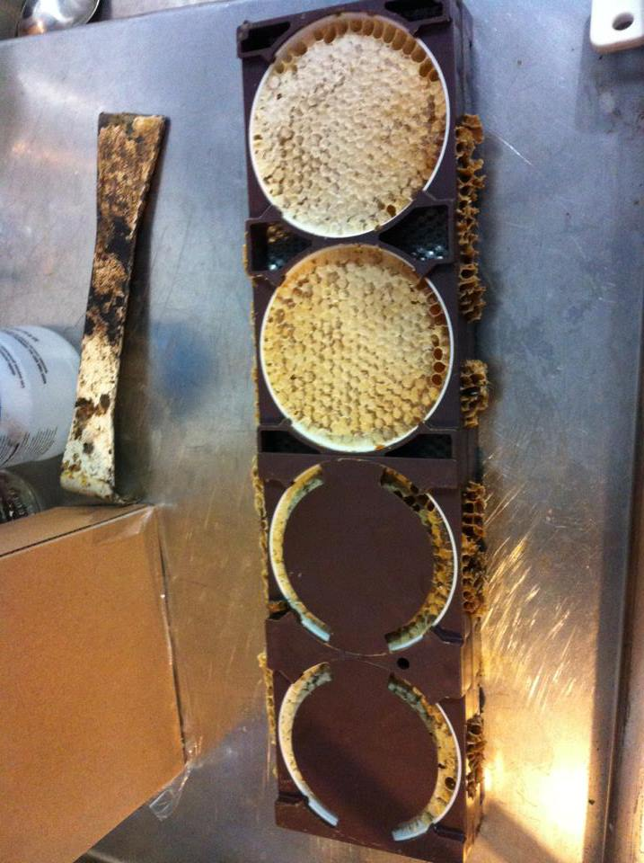
Comb Honey

Slide 9
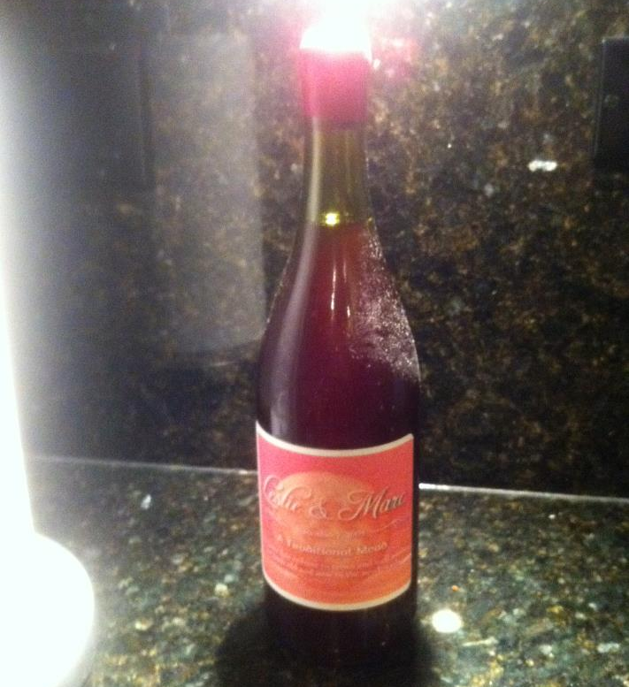
Mead

Slide 10
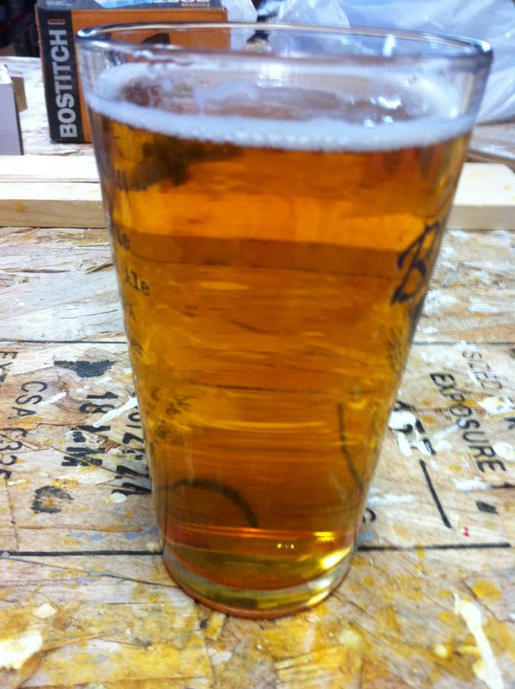
Beer

Slide 11
Questions?
Hit me up on Facebook
Facebook.com/honeypimpapiairies

