Slide 1
Basic Tools & Protective Devices
Tom Pankonen
Honey Pimp Apiaries

Slide 3
Tools
Don’t get caught up in all the “stuff” in the catalogs
Get started with a few items and grow

Slide 4
The Essentials
Smoker
Hive tool
Frame Grip
Propane torch

Slide 5
Smokers
What’s it used for?
Used to “calm” the bees
Disrupts the attack signal
Large and small
With or without shield
Finger guard
Hanger hook

Slide 6
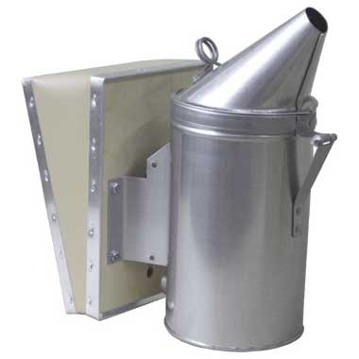
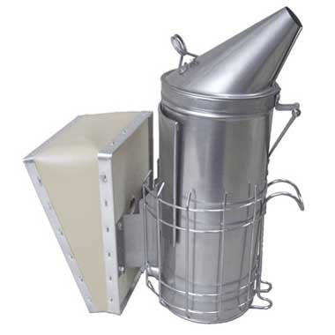
Smoker Images

Slide 7
Smoker Fuel
Pellets
Cotton fiber
Twine / Burlap
Cardboard
Paper
Pine needles / pine cones
Others?

Slide 8
Hive Tool
Separating hive components
Scraping
Lifting and separating frames
Removing staples and nails

Slide 9
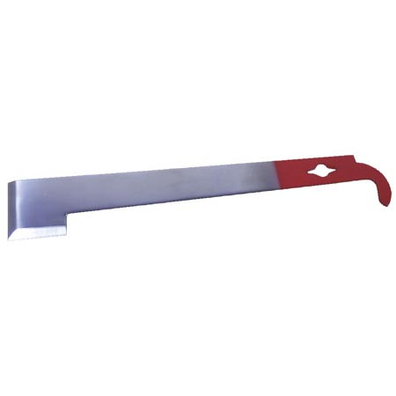
Hive Tools

Slide 10
Frame Grip
Once separated with a hive tool, this allows you to grab the frame
Makes grabbing the frame easier especially if using gloves
Can reduce squished bees

Slide 11
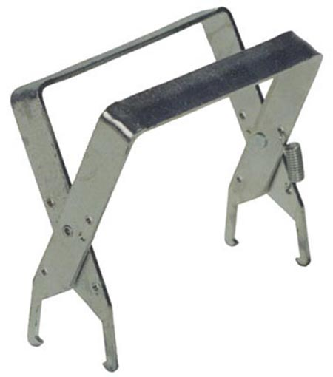
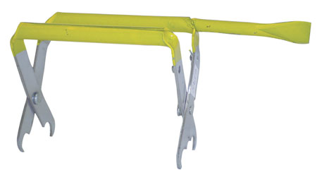
Frame Grip

Slide 12
Protective Clothing
There is NOTHING that’s perfect, your going to get stung!
Veil
Simple, light, compact
Suit
Full protection, hot, restrictive
Jacket
Attached veil, hot, somewhat restrictive

Slide 13
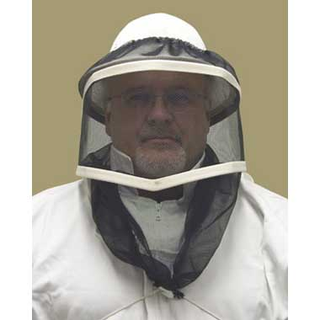
Veils

Slide 14
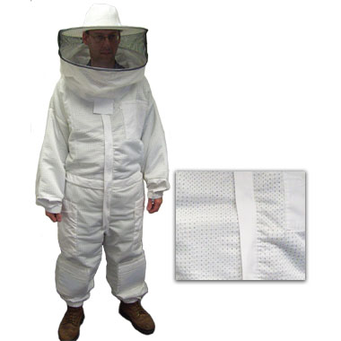
Suits

Slide 15
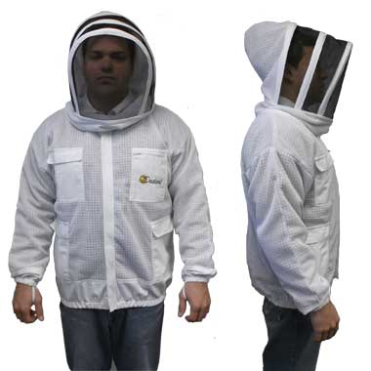
Jackets

Slide 16
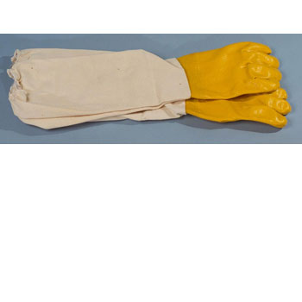
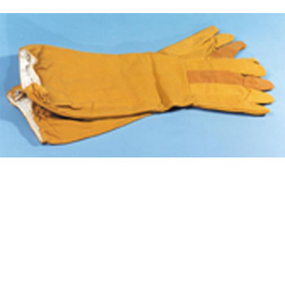
Gloves

Slide 17
Condo Cutout

Slide 18
Closing Comments
Torches are real handy but always have a backup torch, lighter, or matches
Be careful with fire in the field especially in the summer
Practice lighting and keeping your smoker lit
Buy a few hive tools
Buy bright colored hive tools or spray them bright colors
Use something to hold all your gear
Handy boxes
Bucket
Bag

Slide 19
Questions?
Hit me up on Facebook
Facebook.com/honeypimpapiairies

