Slide 1
Wintering Practices
Tom Pankonen
Honey Pimp Apiairies

Slide 3
Wintering starts when its hot out!
Know your mite load throughout the summer
You need to decide if your going to use treatments
Know your options and when to use them
Keep notes!
Leverage the state inspector
Learn to recognize issues BEFORE they become big problems
Winter bees are made late summer

Slide 4
Tips and tricks
Consider replacing failing queens
Inspections are key throughout the season
If you bought out of state packages or nucs consider re-queening with local genetics
September is a good time so she is laying good for winter
When its swarm season consider starting a NUC with a frame of queen cells
Don’t get greedy when harvesting honey, your bees need at least a deep that’s FULL

Slide 5
Tips and tricks
Be sure you have enough honey for the end of summer dearth
Consider feeding late season
Consider storing extra frames of honey in the freezer for emergency feedings through the winter
Make sure there is plenty of pollen, if not feed pollen patties
Combine hives as needed

Slide 6
My winterizing routine
I harvest late season, typically the first week of September
When harvesting I sort frames of uncapped and partially filled frames out to replace on top of the hive for the girls to rob
All supers are removed except what will stay for winter
I return to the hives and inspect the boxes to see how much honey is in the hive and to make sure there is good brood present
I typical give them a week to settle down

Slide 7
My winterizing routine
Combine weak hives
If needed the cluster is moved to the bottom
If the hives are light feeders are filled with 2:1 syrup. I try and leave hives with a deep and a medium
Pollen patties are added
Mouse guard is installed (small entrance facing up)

Slide 8
My winterizing routine
Add foam insulation in my deep inner covers
Ensure top entrances are clear

Slide 9
Wind Block

Slide 10
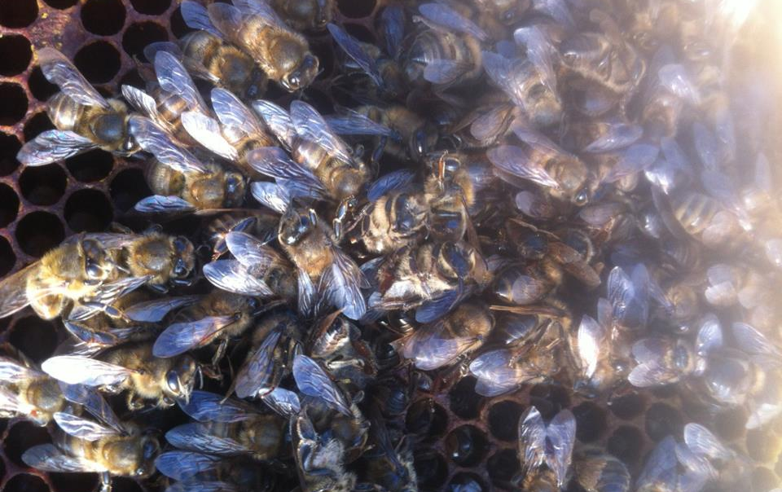
Starved out bees

Slide 11
Baby Mouse

Slide 12
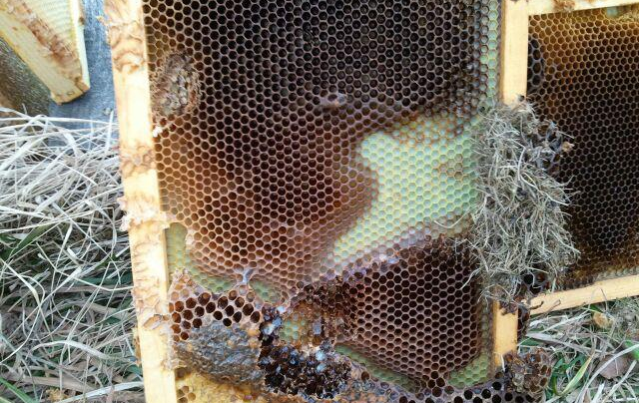
Mouse Damage

Slide 13
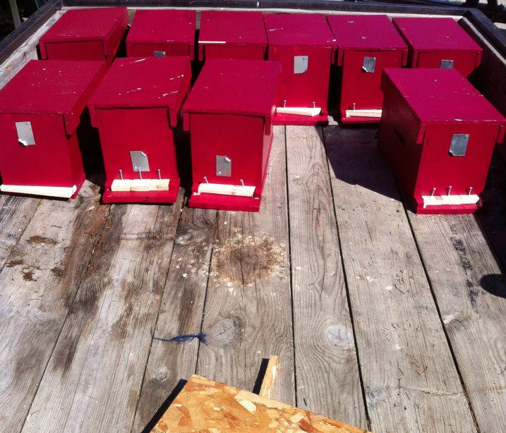
NUCS

Slide 14
Resources
http://www.honeybeesonline.com
Several lessons on:
queen vitality
Wintering practices
Treatments for mites
Emergency feeding
Lots of other good stuff

Slide 15
Questions?
Hit me up on Facebook
Facebook.com/honeypimpapiairies

