Slide 1
Science Literacy and the Levels of Inquiry Model of Science Teaching
Dr. Carl J. Wenning
Physics Department
Illinois State University
Normal, IL U.S.A.

Slide 2
Physics Teacher Education Program Web Site

Slide 3
Science teaching: Historical background
There have been many influential philosophers of education
Experiential Learning (J. Dewey)
Cognitive Load Theory (J. Sweller)
Conditions of Learning (R. Gagne)
Connectionism (E. Thorndike)
Constructivist Theory (J. Bruner)
Experiential Learning (C. Rogers)
Genetic Epistemology (J. Piaget)
Levels of Processing (Craik & Lockhart)
Multiple Intelligences (H. Gardner)
Situated Learning (J. Lave)
Social Development (L. Vygotsky)
Social Learning Theory (A. Bandura)
Subsumption Theory (D. Ausubel)
Information Processing Theory (G. Miller)
but none has dealt effectively with teaching science using inquiry-oriented approaches.

Slide 4
Definitions of inquiry
National Science Education Standards – NRC
National Science Teachers Association - NSTA
“Scientific inquiry refers to the diverse ways in which scientists study the natural world and propose explanations based on the evidence derived from their work. Inquiry also refers to the activities of students in which they develop knowledge and understanding of scientific ideas, as well as an understanding of how scientists study the natural world.”
“Scientific inquiry is a powerful way of understanding science content. Students learn how to ask questions and use evidence to answer them. In the process of learning the strategies of scientific inquiry, students learn to conduct an investigation and collect evidence from a variety of sources, develop an explanation from the data, and communicate and defend their conclusions.”

Slide 5
What is inquiry-oriented teaching?
Inquiry-oriented teaching is “centered”
student centered
knowledge centered
assessment centered
community centered
Inquiry-oriented teaching needs a clearly defined approach that will systematically promote all the scientific process skills expected of someone who is science literate.

Slide 6
What are these process skills?
Asking questions (for science) and defining problems (for engineering)
Developing and using models
Planning and carrying out investigations
Analyzing and interpreting data
Using mathematics and computational thinking
Constructing explanations (for science) and designing solutions (for engineering)
Engaging in argument from evidence
Obtaining, evaluating, and communicating information
Source: Next Generation Science Standards, National Academy Press (2013).

Slide 7
There is a greater need for guidance.
Science teaching
A life-changing event
Traditional approaches:
teacher seen as an authority
“received” knowledge
emphasis on equations and answers
Inquiry approaches:
teacher seen as facilitator
construction of knowledge
emphasis on questions and conceptual understanding

Slide 8
Levels of Inquiry Model of Science Teaching
Moulton Hall at I.S.U.
Talk Outline
Fundamental Questions
The Inquiry Spectrum
Need for Dialogue
Learning Sequences

Slide 9
Two fundamental questions:
What is the goal of science teaching?
Science Literacy
Knowledge: science as both content and process including nature and history.
Skills: critical thinking, scientific reasoning, and problem-solving skills.
Dispositions: informed thoughts, values, and actions.
How do we best teach content, intellectual process skills, and problem-solving skills?
Levels of Inquiry Method of Science Teaching

Slide 10
The Inquiry Spectrum
Intellectual sophistication changes along spectrum
(Low to left and high to right)
Discovery Learning | Interactive Demonstrations | Inquiry Lessons | Inquiry Labs | Real-world Applications | Hypothetical Explanations
Locus of control changes along spectrum
(Teacher to left and student to right)

Slide 11
Discovery Learning
Pedagogical Purpose
Students develop concepts (and learn name for new concepts) and principles based on first-hand experiences.
Discovery Learning | Interactive Demonstrations | Inquiry Lessons | Inquiry Labs | Real-world Applications | Hypothetical Explanations
Rudimentary Skills:
Observing
Classifying
Formulating concepts
Estimating
Drawing conclusions
Communicating results

Slide 12
Interactive Demonstrations
Pedagogical Purpose
Students are engaged in explanation and prediction-making that allows teacher to elicit, identify, confront, and resolve alternative conceptions.
Discovery Learning | Interactive Demonstrations | Inquiry Lessons | Inquiry Labs | Real-world Applications | Hypothetical Explanations
Basic Skills:
Predicting
Explaining
Estimating
Acquiring and processing data
Formulating and revising scientific explanations
Recognizing and analyzing alternative explanations

Slide 13
Inquiry Lessons
Pedagogical Purpose
Students identify scientific principles and/or relationships by working with a teacher who demonstrates the inquiry process and uses a “think aloud” protocol throughout.
Discovery Learning | Interactive Demonstrations | Inquiry Lessons | Inquiry Labs | Real-world Applications | Hypothetical Explanations
Intermediate Skills:
Measuring
Collecting and recording data
Constructing a table of data
Designing and conducting scientific investigations
Using technology and math
Describing relationships

Slide 14
Inquiry Labs
Pedagogical Purpose
Students, working primarily on their own, establish empirical laws based on measurement of variables under controlled conditions.
Discovery Learning | Interactive Demonstrations | Inquiry Lessons | Inquiry Labs | Real-world Applications | Hypothetical Explanations
Integrated Skills:
Measuring metrically
Establishing empirical laws on the basis of evidence and logic
Designing and conducting controlled scientific investigations
Using sensors and graphical analysis during investigations

Slide 15
Real-world Applications
Real-world Applications
Students solve problems related to authentic situations while working individually or in cooperative and collaborative groups using problem-based and project-based approaches.
Discovery Learning | Interactive Demonstrations | Inquiry Lessons | Inquiry Labs | Real-world Applications | Hypothetical Explanations
Culminating Skills:
Collecting, assessing, and interpreting data from a variety of sources
Constructing logical arguments based on scientific evidence
Making & defending evidence-based decisions and judgments
Clarifying values in relation to natural and civil rights
Practicing interpersonal skills

Slide 16
Hypothetical Explanations
Pedagogical Purpose
Students develop and test hypotheses that serve as tentative explanations for observed phenomena and guides for further experimentation.
Discovery Learning | Interactive Demonstrations | Inquiry Lessons | Inquiry Labs | Real-world Applications | Hypothetical Explanations
Advanced Skills:
Synthesizing and testing complex hypothetical explanations
Analyzing and evaluating scientific arguments
Generating predictions through induction
Revising hypotheses in light of new data

Slide 17
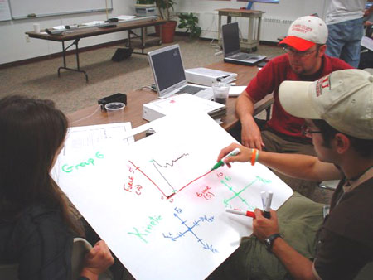
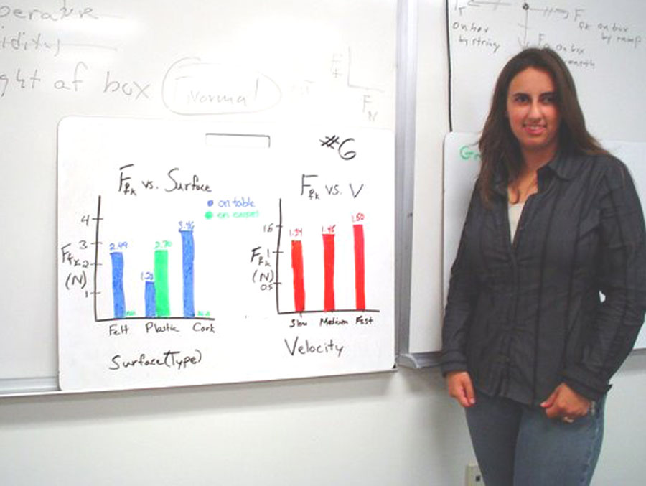
Effective inquiry teaching will…
include argumentation from facts with the use of discussion, whiteboarding, & Socratic dialogues.
effectively address alternative conceptions:
elicit
identify
confront
resolve
Reinforce
be based on learning sequences

Slide 18
Learning sequence example: Buoyancy
Buoyancy | Pedagogical Practice – Sinking Objects
Discovery Learning | Students reflect on mental models, experience floating and sinking, as well as buoyant force.
Interactive Demonstrations | Students develop a relationship between weight in air, in water, and the buoyant force.
Inquiry Lessons | Students identify factors that might influence buoyant force and conduct simple tests.
Inquiry Labs | Students establish empirical law for volume of immersed object and density of liquid, F=ρVg.
Real-world Applications | Students apply new knowledge to authentic situations individually or in small groups.
Hypothetical Explanations | Students generate explanations for pressure at depth, P=ρgh, and source of buoyant force.

Slide 19
Levels of Inquiry Model Application
Curriculum Planning
Teach the subject matter that you can best teach using inquiry-oriented approaches.
Instructional Development
Prepare learning sequences that incorporate all levels of inquiry to the greatest extent possible.
Research Opportunities
Discovery Learning | Interactive Demonstrations | Inquiry Lessons | Inquiry Labs | Real-world Applications | Hypothetical Explanations

Slide 20
Resources
Levels of inquiry: Hierarchies of pedagogical practices and inquiry processes. Journal of Physics Teacher Education Online, 2(3), February 2005, pp. 3-11.
Levels of inquiry: Using inquiry spectrum learning sequences to teach science. Journal of Physics Teacher Education Online, 5(4), Summer 2010, pp. 11-19.
The Levels of Inquiry Model of Science Teaching. Journal of Physics Teacher Education Online, 6(2), Summer 2011, pp. 9-16.
Sample learning sequences based on the Levels of Inquiry Model of Science Teaching including Appendix. Journal of Physics Teacher Education Online, 6(2), Summer 2011, pp. 17-30.
Dealing more effectively with alternative conceptions in science. Journal of Physics Teacher Education Online, 5(1), Summer, 2008, pp. 11-19.
Whiteboarding and Socratic dialogues: Questions and answers. Journal of Physics Teacher Education Online, 3(1), September, 2005, pp. 3-10.
http://www.phy.ilstu.edu/pte/publications/

