Slide 2
Levels of Inquiry Model of Science Teaching The Simple Pendulum Learning Sequence
Dr. Carl J. Wenning
Department of Physics
Illinois State University

Slide 3
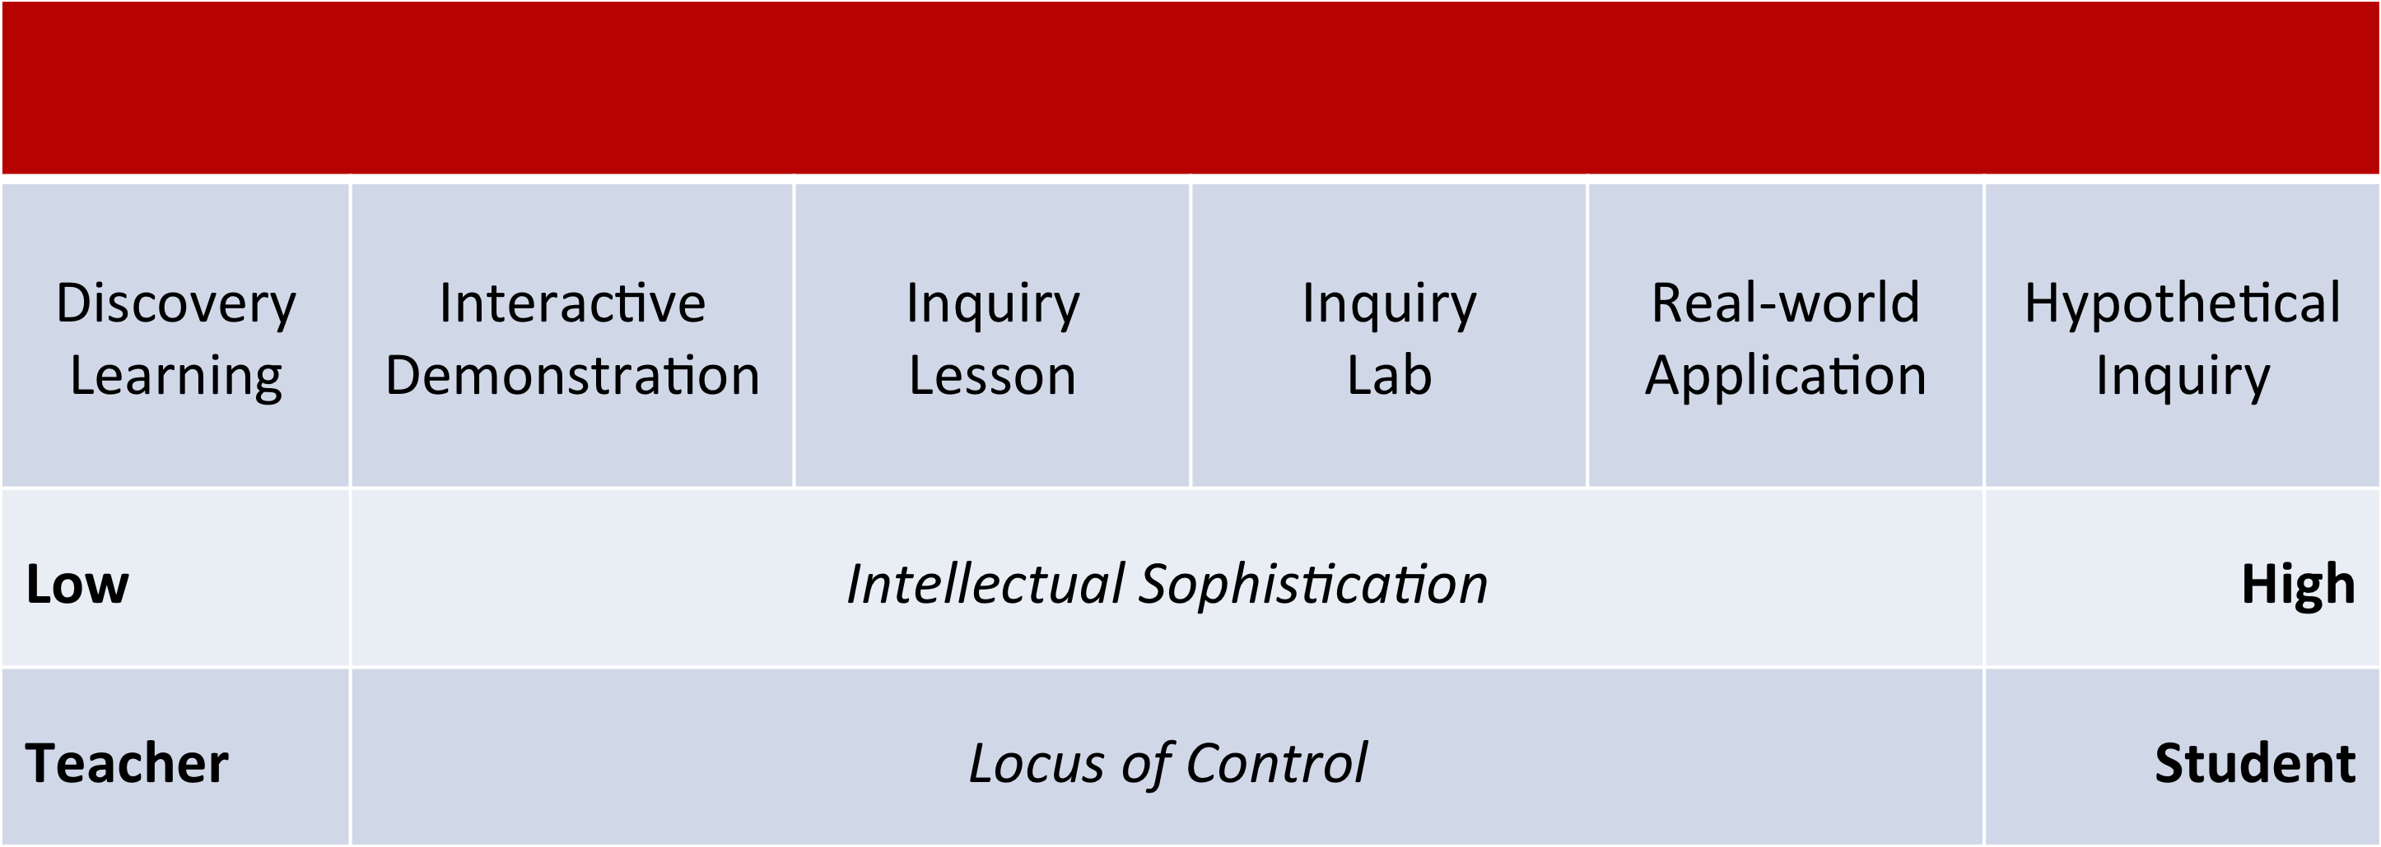
communication
Levels of Inquiry Model of Science Teaching

Slide 4
communication
Simple Pendulum Learning Sequence
Discovery Learning: Students develop concepts and qualitative relationships. They characterize the system and identify measurable quantities such as mass, length, amplitude, period, and gravity. They “play” with varying pendulum configurations to find relationships between period and system variables.

Slide 5
Work Time
Discovery Learning -
Characterize the system and identify measurable quantities (variables).
“Play” with different pendulum configurations to find simple relationships.

Slide 6
communication
Simple Pendulum Learning Sequence
Interactive Demonstration: Students predict and observe. (e.g., What happens to period if I double the mass? What happens if I double the amplitude? What happens if I double the length?). Following predictions, students make data tables of mass vs. period, amplitude vs. period, and length vs. period and draw conclusions.

Slide 7
Work Time
Interactive Demonstration - What will happen when I double the mass, amplitude, length?
Predict
Verify

Slide 8
communication
Simple Pendulum Learning Sequence
Inquiry Lesson: Students participate in a teacher-conducted controlled experiment. Using stopwatches, meter sticks, and protractors (under constant “g ”), they collect data to determine the exact relationship between length and period.

Slide 9
Work Time
Inquiry Lesson - Determine the relationship between length and period of a simple pendulum.

Slide 10
communication
Simple Pendulum Learning Sequence
Inquiry Lab (preparation): Teachers helps students see that the slope of the length vs. period graph can be related to the gravitational force constant, g, by using dimensional analysis.

Slide 11
Dimensional Analysis

Slide 12
communication
Simple Pendulum Learning Sequence
Inquiry Lab: Students design and conduct a controlled scientific experiment to determine the acceleration due to gravity, g. Use the best values of length and period. Determine how errors in length and period result in errors in g.

Slide 13
Work Time
Inquiry Lab - Determine the acceleration due to gravity, g, using a simple pendulum.

Slide 14
Controlled experiment?
Best values of length and period?
How do errors in length and period affect g?

Slide 15
Best Values
One-swing measurement?
Average of several one-swing measurements?
1/10 of one 10-swing measurement?
Average of several 10-swing measurements?
Errors in representative values?
Range?
Mean deviation?
Standard deviation?

Slide 16
Error Propagation

Slide 17
communication
Simple Pendulum Learning Sequence
Real-world Applications 1: Students solve end-of-chapter “puzzles” applying the relationship for period and length to any of a number of situations. For example, “What is the period of a pendulum of a given length?” or any other combination of period, length, and value of g.

Slide 18
communication
Simple Pendulum Learning Sequence
Real-world Applications 2: Students solve real-world problems. For instance, (1) “Use Newton’s 2nd law of motion and law of gravitation to determine the mass of Earth.” and (2) “Given a pendulum’s period, determine the radius of Earth for a given location.”

Slide 19
Work Time
Use Newton’s 2nd law of motion and law of gravitation to determine the mass of Earth.

Slide 20
communication

Slide 21
Work Time
Given a simple pendulum’s period, determine the radius of Earth for a given location.

Slide 22
communication

Slide 23
communication
Simple Pendulum Learning Sequence
Hypothetical Inquiry: Not all topics within a given learning sequence have pure or applied situations. Can you think of any for a simple pendulum?

Slide 24
communication
Why inquiry?
Students learn the content, processes, history, nature, and values of science.
Why Levels of Inquiry?
By progressing through each of the different levels of inquiry, students learn increasingly sophisticated intellectual process skills – critical thinking, scientific reasoning, and experimental inquiry skills.

Slide 25
Resources:
Levels of Inquiry
www.phy.ilstu.edu/pte/publications/
Student Laboratory Handbook
www.phy.ilstu.edu/slh/
Dr. Carl J. Wenning
wenning@phy.ilstu.edu

