Slide 1
Intellectual Process Skills (within Levels of Inquiry)
Dr. Carl J. Wenning
Department of Physics
Illinois State University
Normal, Illinois USA

Slide 2
The Value of an Education
It is not so very important for a person to learn facts…. He can learn them from books. The value of an education…is not the learning of many facts, but the training of the mind to think something that cannot be learned from textbooks.
Albert Einstein

Slide 3
Traditional Textbook Learning
Loss of retention after learning from textbooks:
After 1 day, 46% of material is forgotten
After 1 week, 65% of material is forgotten
After 2 weeks, 79% of material is forgotten
After 2 months, 83% of material is forgotten
What remains thereafter is the “hidden curriculum” which is not always what we want…
“Science is difficult and boring.”
“I hate physics and the physics teacher.”

Slide 4
Traditional Teaching
Based on teacher and textbook authority, not on a legitimate scientific epistemology. Such instructional practices are closely related to religious instruction, not the empiricism of science.
If science is taught as product, and not as both product and process, we are teaching history and not science.

Slide 5
Intellectual Skills in Science
Intellectual skills consist of two things:
Critical thinking
Scientific reasoning
Thinking and reasoning are not interchangeable terms:
Critical thinking is related to determining the worth of something
Scientific reasoning is related to making sense of a set of facts or circumstances

Slide 6
Intellectual Skills and Effort
Intellectual skills do not translate automatically to success; they are only part of a much wider group of requirements given by S = A_{i}A_{l}ME₁E₂.
Intellectual skills require effort if they are to bear fruit. Consider…
Isaac Newton
Albert Einstein
Charles Darwin
Thomas Edison

Slide 7
Importance of Intellectual Skills
Intellectual skills are an essential component of science literacy.
While people might “know” facts, that does not mean that they can use them meaningfully.
We teach facts in high school, but how many graduates know how to apply them to real-world situations?
How many graduates are science literate?

Slide 8
Critical Thinking Skills
Identify and clarify problems
Ask appropriate questions
Analyze situations
Distinguish between fact and inference
Evaluate relevant information and outcomes
Make predictions
Identify and evaluate assumptions
Draw conclusions based on evidence
Assess one’s own thinking

Slide 9
Scientific Reasoning Skills
Raise questions on the basis of observations
Propose hypothetical explanations
Create an observational and/or experimental protocol
Generate predictions on the basis of an available hypothesis
Gather and interpret data from observation and/or experiment
Draw evidence-based conclusions
Employ creative, probabilistic, correlational, and combinatorial thinking as appropriate
Think carefully about assumptions, implications, and consequences
Communicate results clearly, concisely, and accurately
Compare and defend scientific claims

Slide 10
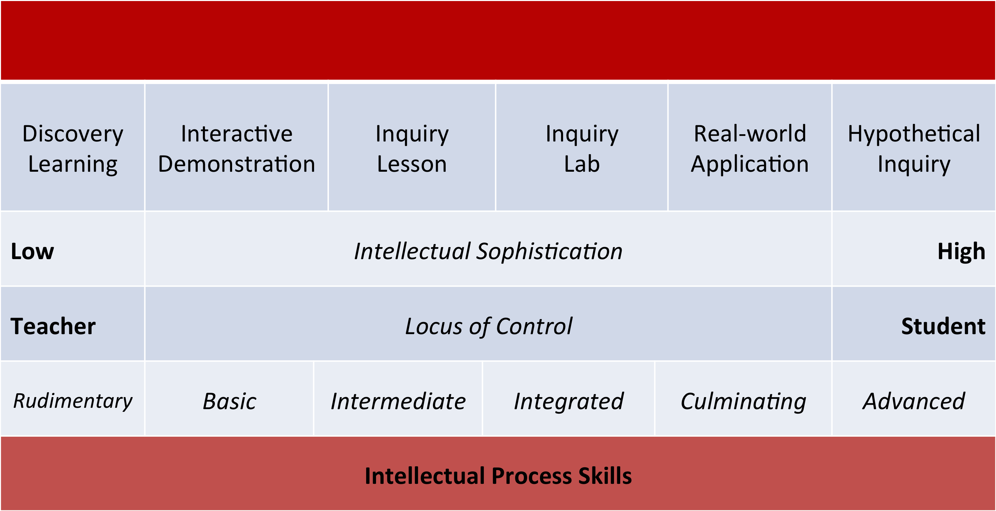
Intellectual Skills and Levels of Inquiry

Slide 11
Rudimentary: Discovery Learning
Classifying
Ordering
Observing
Acquiring qualitative data
Formulating concepts
Drawing conclusions
Communicating results

Slide 12
Basic: Interactive Demonstrations
Estimating
Predicting
Using proportional thinking
Using conditional thinking
Explaining
Formulating and revising scientific explanations using logic and evidence
Recognizing and analyzing alternative explanations and models

Slide 13
Intermediate: Inquiry Lessons
Applying information
Using correlational thinking
Using combinatorial thinking
Helping with the design and execution of controlled scientific experiments
Measuring
Collecting and recording quantitative data
Making simple sense of quantitative data
Describing relationships

Slide 14
Integrated: Inquiry Labs
Defining the problem and the system to be studied
Distinguishing independent from dependent variables
Designing and conducting controlled scientific investigations
Using probabilistic thinking
Using technology and math during investigations
Establishing laws on the basis of evidence and logic

Slide 15
Culminating: Real-world Applications
Collecting and evaluating data from various sources
Making and defending evidence-based conclusions and judgments of arguments based on the logical interpretation of scientific evidence and other criteria.
Solving complex real-world problems

Slide 16
Advanced: Hypothetical Inquiry
Creating abstract hypothetical explanations
Analyzing and evaluating scientific arguments
Thinking analogically
Generating predictions through the process of deduction
Evaluating and revising hypotheses in light of new evidence
Creating a unique communication

Slide 17
Characteristics of the Intellectual Classroom
What is seen in a classroom where a teacher promotes intellectual process skills?
A “centered” classroom (student, knowledge, community and assessment centered)
Inquiry-oriented learning - students cooperatively constructing knowledge from experience
Students applying new knowledge to complex, authentic real-world problems, not merely textbook “puzzles”, using project- and problem-based strategies

Slide 18
The Intellectual Classroom Teacher
Teacher understands both the content and process of science.
Teacher intentionally incorporates intellectual skills through proper planning, teaching, and assessing.
Teacher wisely uses a wide range of the Levels of Inquiry Method of Science Teaching.
Teacher uses four “centers” of teaching: student, community, knowledge, and assessment.

