Slide 1
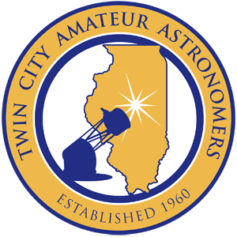
Sky Interpretation
Dr. Carl J. Wenning
Twin City Amateur Astronomers

Slide 2
Twin City Amateur Astronomers

Slide 3
0.5m and 0.28m telescopes

Slide 4
0.4m and 0.25m telescopes

Slide 5
Recent Work

Slide 6
More Recent Work

Slide 7
Even more recent work

Slide 8
What is sky interpretation?
Sky Interpretation is the art and process of coupling direct observation with skilled communication for the purpose of informing people about the sky, its objects, and phenomena, with special emphasis on relationships of these to Earth and its occupants.
Von Del Chamberlain

Slide 9
Why interpret the sky?
People are curious about their entire environment.
The contrast between city sky and country sky at night is profound.
People are amazed when they see a dark night sky.
People appreciate looking through a telescope.
People need to understand our relationship to the rest of the universe.
People won’t preserve what they don’t appreciate, won’t protect what they don’t know about, and won’t defend what they don’t understand.

Slide 10
What we need to know…
Solar motions
Lunar motions and appearances
Sun and moon interactions
Space-atmosphere interactions
The stars and their motions
Planetary motions
Milky Way

Slide 11
Other considerations…
Use of telescopes
Twilight
Dark adaption
Light pollution
Laser pointers
American tradition of camping

Slide 12
Interpretive Sessions
Park settings:
Lecture hall and amphitheater presentations
Campfire circle presentations
Twilight walk and skywalk presentations
TCAA public observing sessions:
Evening talk
Constellation study
Telescope viewing session

Slide 13
Illustrations using Voyager 4.5

